Slide 1
Basics of Observations
and
Galaxy Evolution
Ayan Acharyya
Mount Stromlo Observatory, Australian National University
ARC Centre of Excellence for All Sky Astrophyiscs in 3D (ASTRO3D)
Notes:
Hello everyone, hope everyone is safe and sound amidst this pandemic.
In the series of fb live talks, you have already heard about solar systems, moons and planets, including exoplanets. Today we are going to talk about something bigger than planets and solar systems, bigger even than galaxies - we are going to talk about the whole universe! In fact, we are going to talk about the distant past..when the Universe was a baby
introduce, time of talk

Slide 2

About Me
Who am I?
Recently completed PhD from Australian National University
What do I research on?
I look back in time to find building blocks of life
What am I going to do today?
Demonstrate how we can study evolution of galaxies using observations
Courtesy: Ryan Ridden-Harper
Notes:
I am a PhD student at MSO….I look for building blocks of life in the past universe. This raises two questions: where are the building blocks of life formed, and how can we see into the past to find them?

Slide 3
Basic Introduction
to
Simulations vs Observations
“…so I hope those who do know will forgive me for giving a short explanation,
and allow their attention to wander freely.” — Albus Dumbledore

Slide 4
Observations
Simulations
Directly looking at galaxies/stars/planets
Through powerful telescopes^
Advantage: What we observe *is* the reality
Involves collection, analysis and measurement from observed data
Toy models of the Universe/galaxies/stars/planets
Created inside a computer
Advantage: Full control on how I want my galaxies to behave
Involves intensive computer programming
^Sometimes involves travel to beautiful locations…
Notes:
To answer the first question, I’m going to show you a set of videos of simulations in the next few slides. So let’s first understand what IS a simulation?

Slide 5
Let us first narrow down on the question using Simulations…
…and then we will try to answer it using Observations

Slide 6
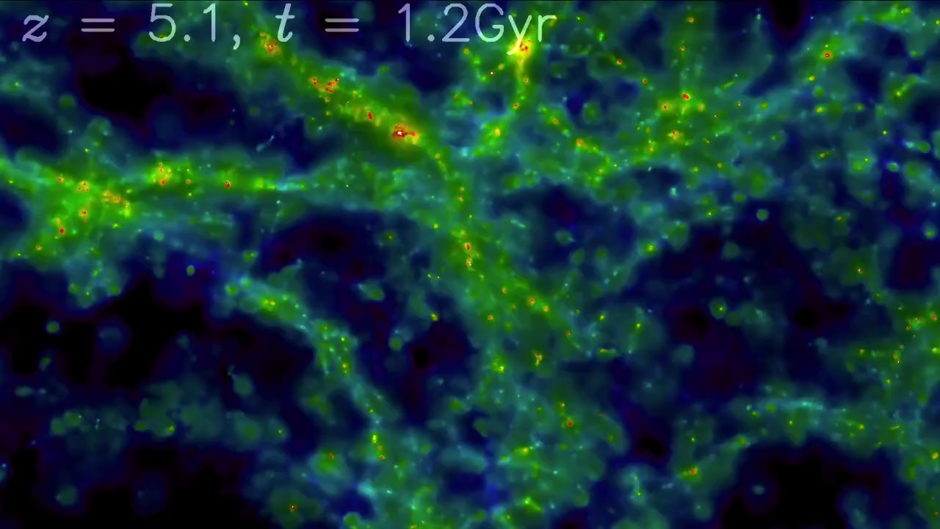
A Universe was born…
Notes:
The yellow/red colors you see are where the new elements are being formed in the universe

Slide 7
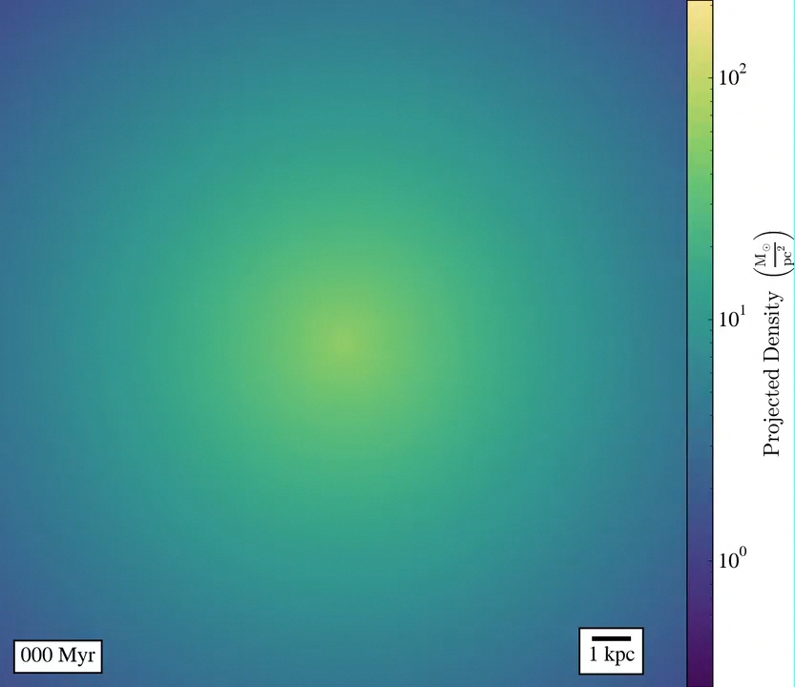
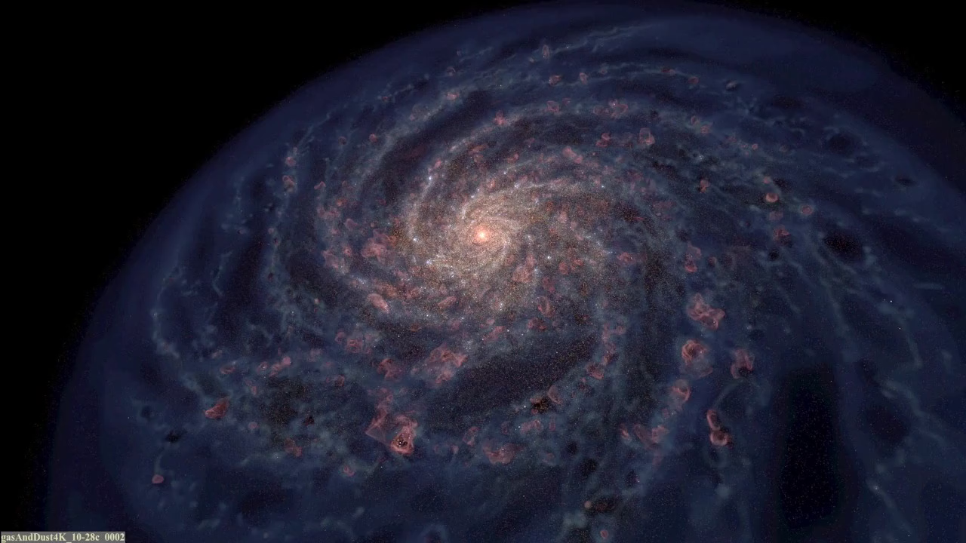
Inside the Universe, galaxies were born..

Slide 8
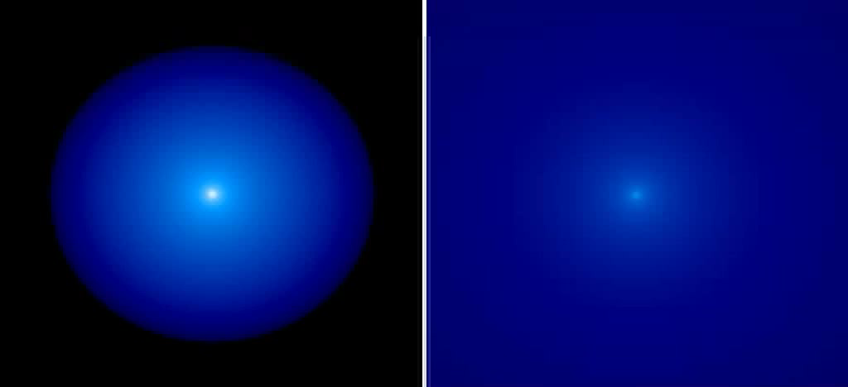
Inside the galaxies, stars were born..

Slide 9
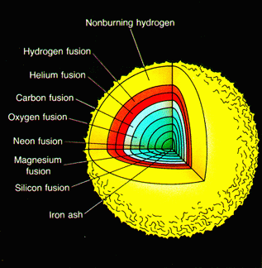
..and stars produce elements through fusion
http://wtlab.iis.u-tokyo.ac.jp/wataru/lecture/rst/Sect20/A7.html
..and these elements form the building blocks of life!

Slide 10
Production/accumulation of these elements in galaxies impacts how galaxies grow and evolve
Information about this evolution is contained in the light from the galaxies
Therefore, our aim is to collect the light
But light from which galaxies?

Slide 11
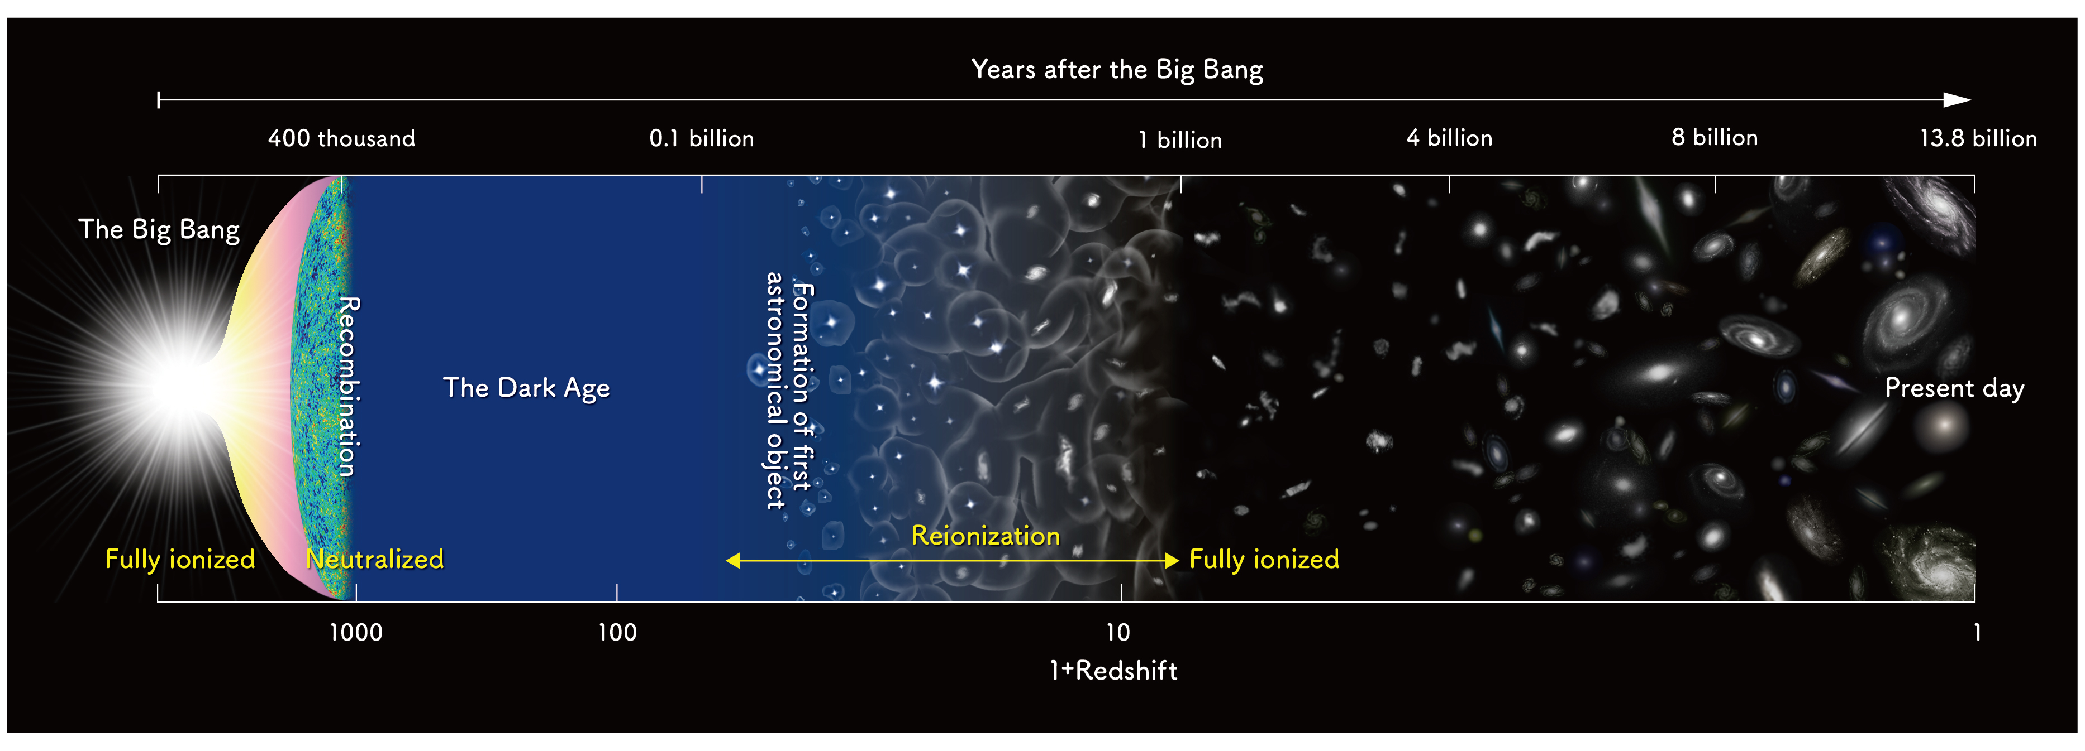


Where it all began…
Past
Present day
astrobites.org
Distant universe: poorly understood
Local universe: fairly well studied
Notes:
to quote the popular tv series big bang theory: “Our whole universe was in a hot, dense state
Then nearly fourteen billion years ago expansion started”..atoms formed..they formed the very first gas cloud..from which formed the stars..then the first galaxies. With time, these galaxies grew, merged and formed bigger, newer galaxies and inside them formed newer generation of stars..until we have the universe that we see around us in the present time.
due to its proximity, the local universe is fairly well studied, but the more distant universe, in other words, the high-redshift universe is still a gray area. and that’s what i will focus on.

Slide 12
But how do we actually see the past?

Slide 13





Newborn
5 Years later
15 Years later
25 Years later
5 Years away
15 Years away
25 Years away
Notes:
So whats this whole business about seeing the baby universe? Can we actually travel back in time and see how the universe looked in the past? Well, turns out we can! And it’s all got to do with the speed of light! (Speed of light -very fast - CBR-SYD question) Now imagine a baby is born, well you dont really have to imagine, babies are born in reality every now and then as it turns out, Then the light leaving that room where the baby is born starts travelling..and in five years reaches here..by the time the baby has actually grown up by 5 years..but the light is still going on and on..now fast forward 10 more years..the baby is now a young boy..the light that left the baby has reached here..and the light from the kid has now reached here. Now if there were an alien right here, 15 light years away from the earth, looking at the earth wth a very very powerful telescope, they’d see the image of the newborn baby! if the alien were here instead, they’d see the image of the kid, although he has now grown older. Extending this analogy further, few more years later, the light from the baby will reach another alien here even though in reality the baby has now grown into a man. So this is how we basically look into the past of our universe - by looking at galaxies that are very very far away.

Slide 14
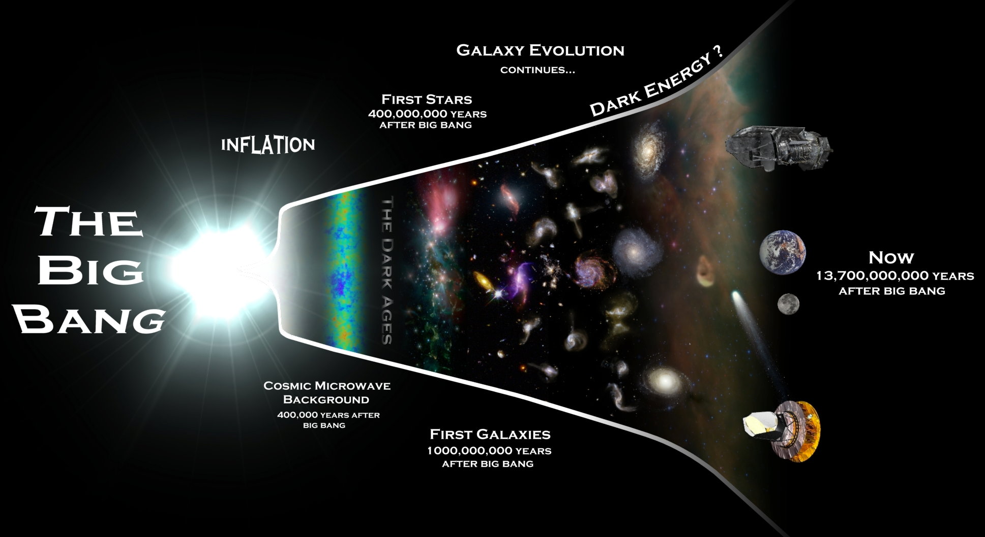
Notes:
Now let’s look at it in terms of our universe okay? So about 14 billion years ago..one fine moment..suddenly we had this big freaking bang and the universe came into existence. Since a little while after that, light has been traveling outwards..till this day..so imagine the initial times as a baby and then the universe grew bigger into a young kid and so on..

Slide 15



How do we collect the light from the past?
Telescopes!
Bucket collecting rain
Telescope collecting photons

Slide 16
How do we collect the light from the past?
Bigger telescopes!
Bigger bucket -> more rain
Bigger telescope -> more photons

Slide 17
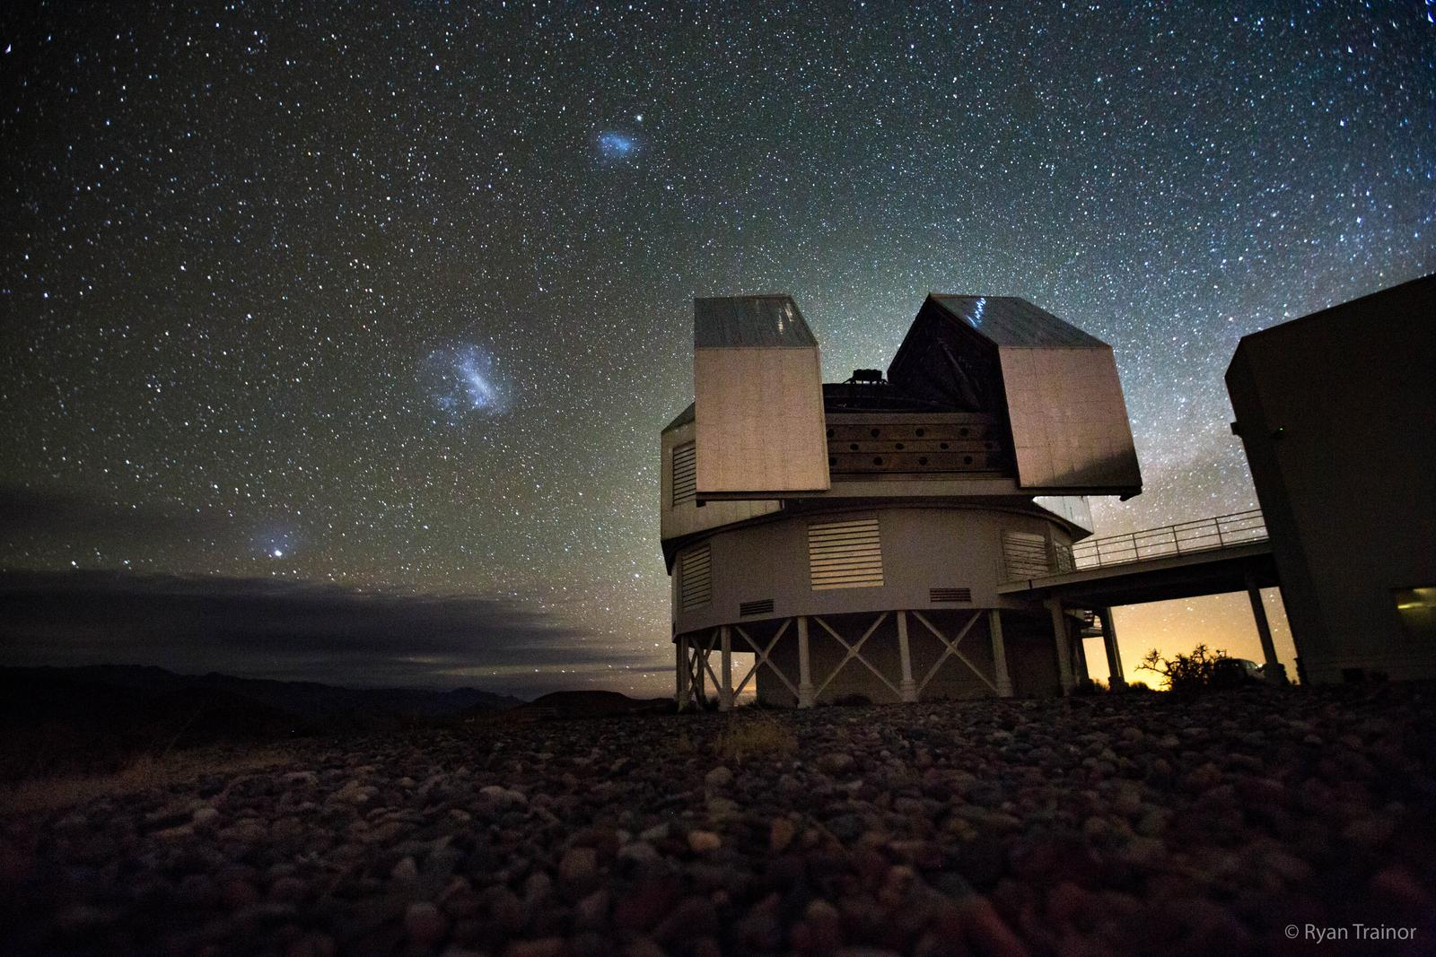
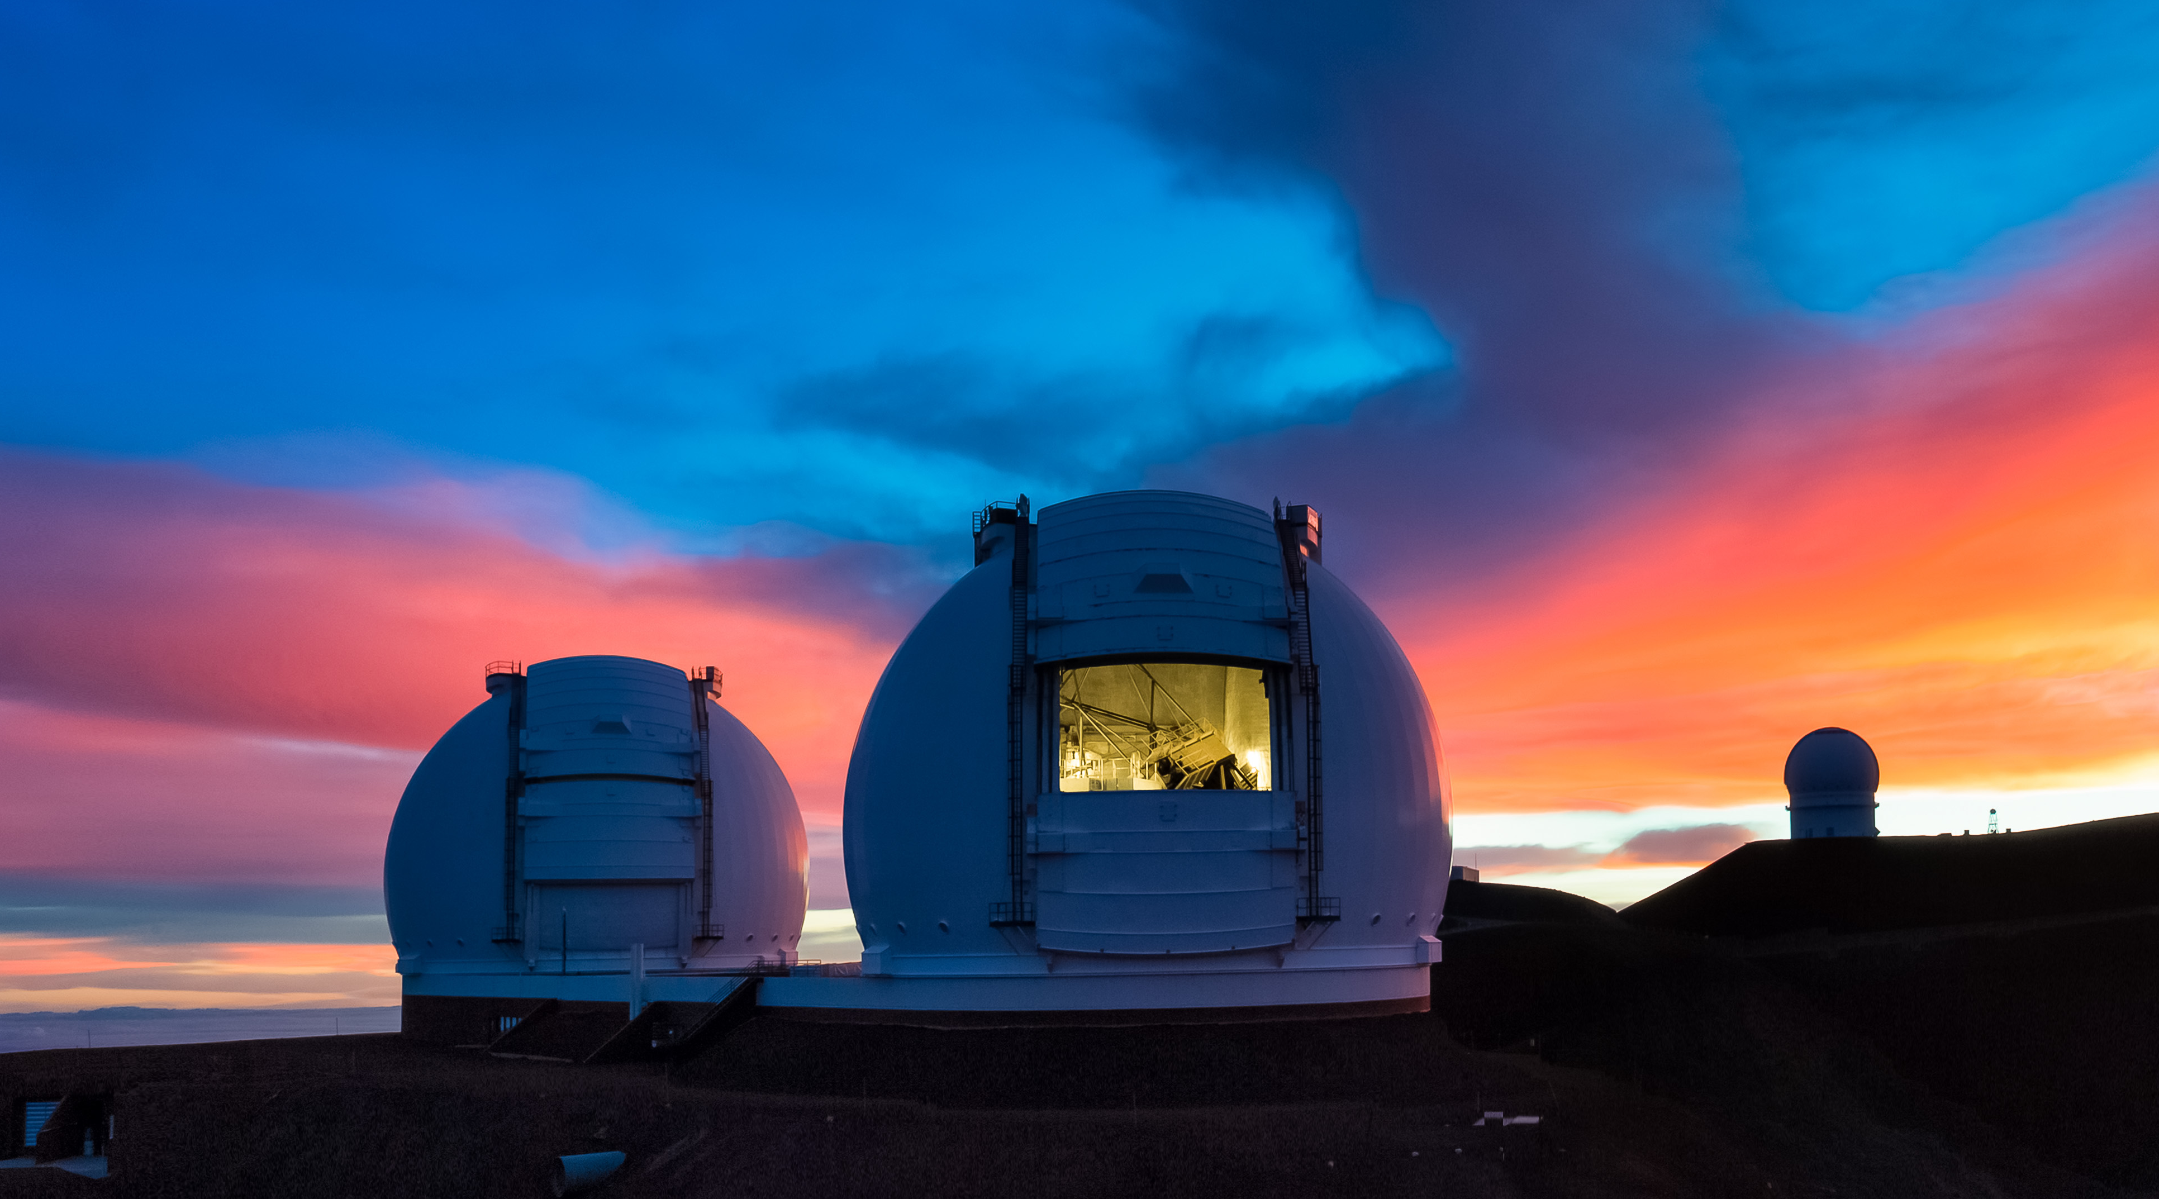
Current ground-based observatories
Keck Telescopes (Hawaii)
Image Credits: imgur.com
Magellan telescope (Chile)
Image credits: Keck Observatory

Slide 18
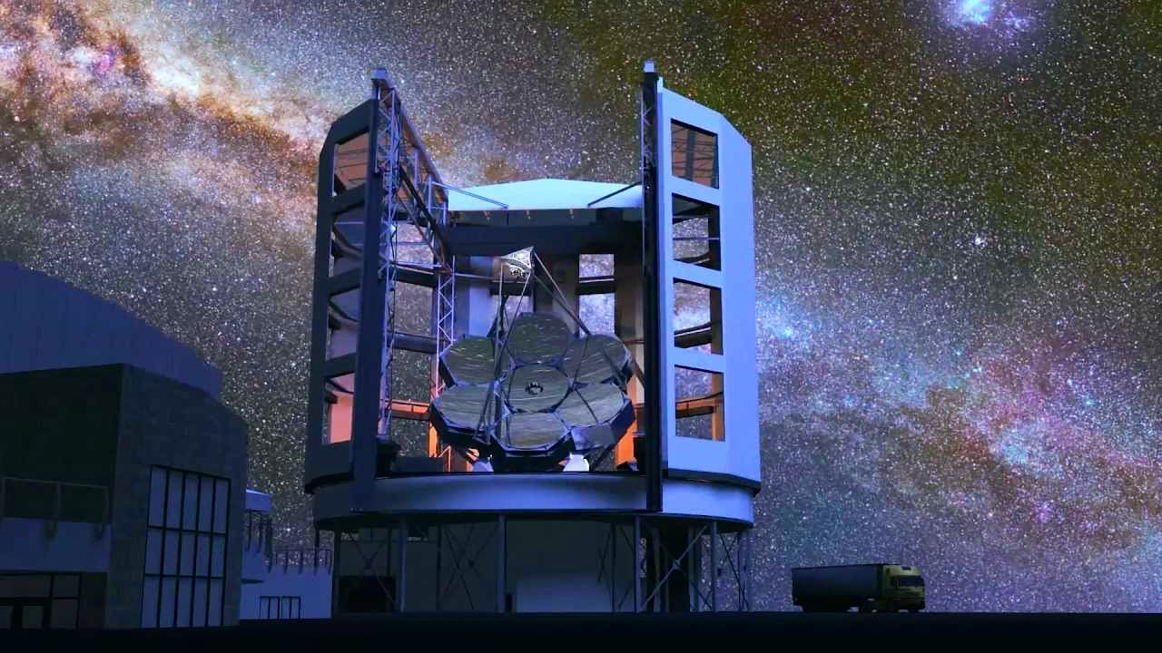
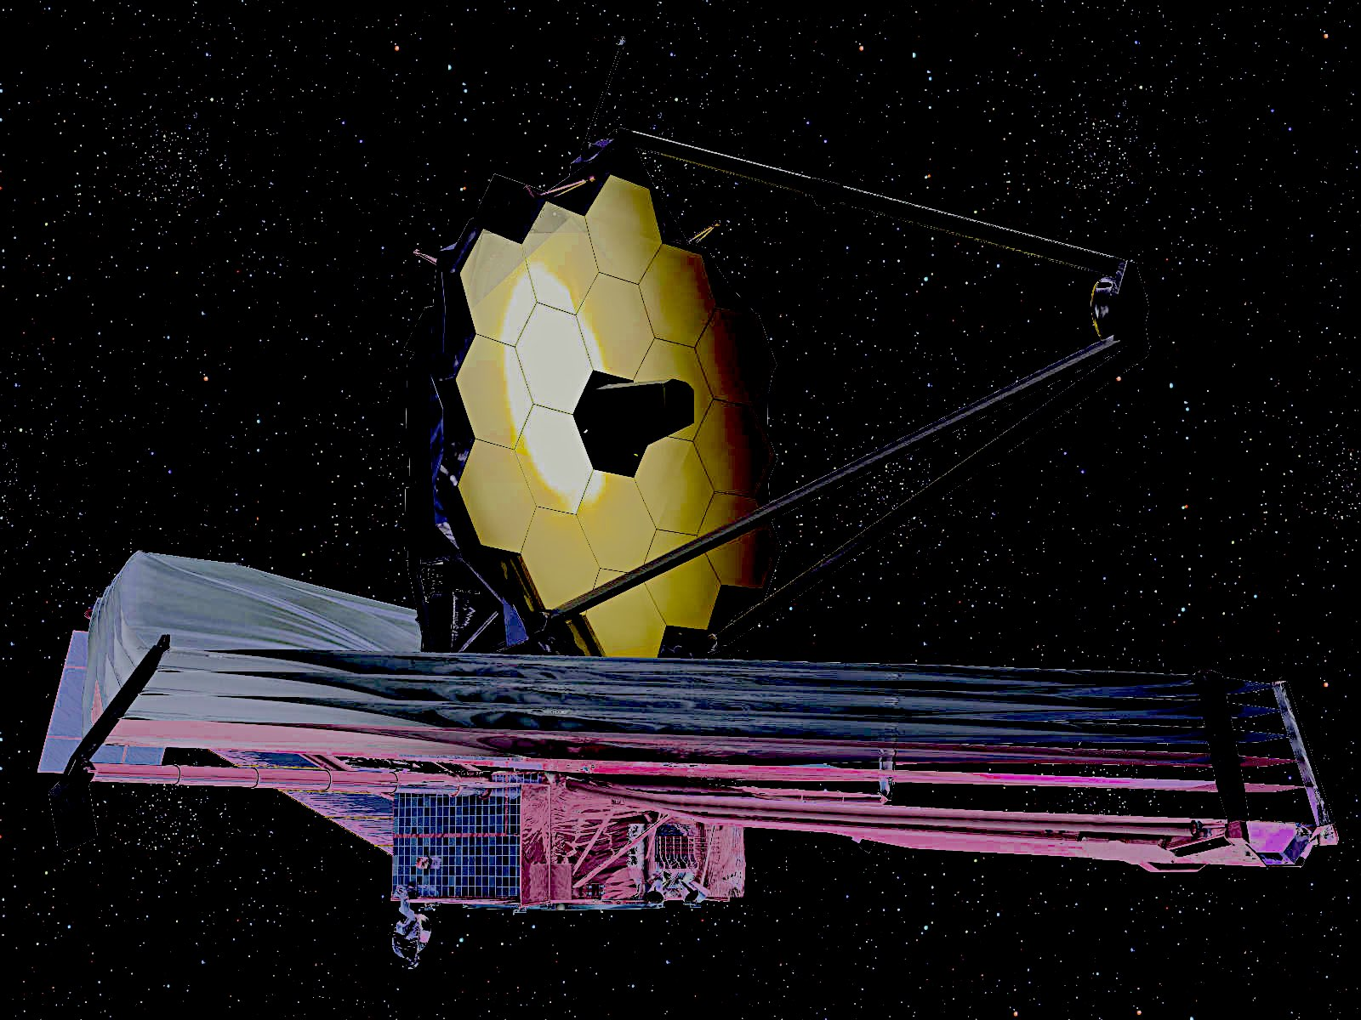
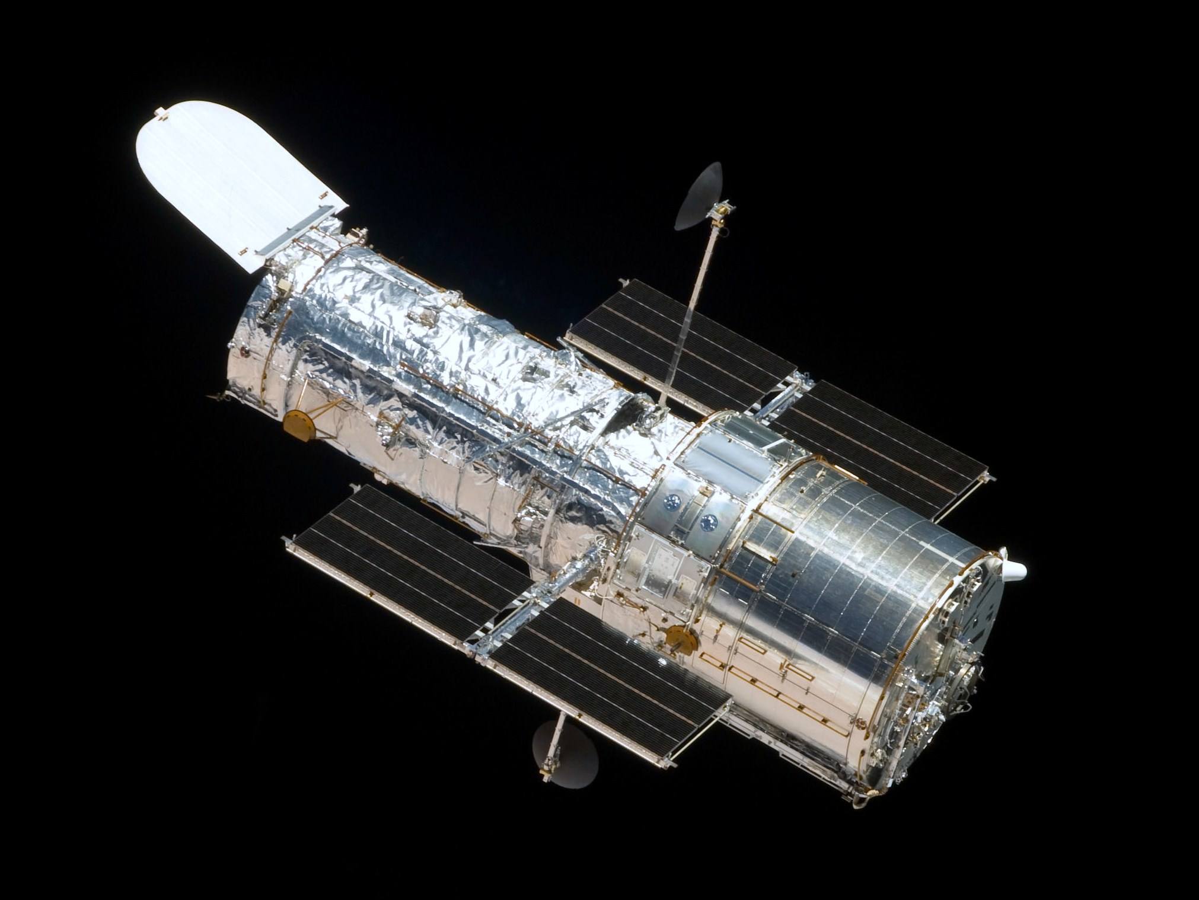
Giant Magellan Telescope (under construction)
Hubble Space Telescope (in orbit since 1990)
James Webb Space Telescope (will be launched in 2021)

Slide 19
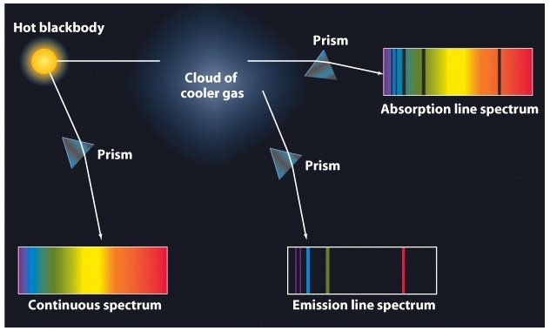
What do we look for?
Spectra
Notes:
When the light from the new stars shine through this already enriched nebular clouds, they excite the metal atoms which leads to emission lines in our spectra. Now the difference in mechanisms of various spectra can be roughly understood from this cartoon diagram here. Which basically says that if we’re looking at a gas cloud illuminated by embedded stars, we should be able to see a combination of stellar continuum, absorption and emission line spectra. For the purpose of this talk, we are interested only in the emission lines.

Slide 20
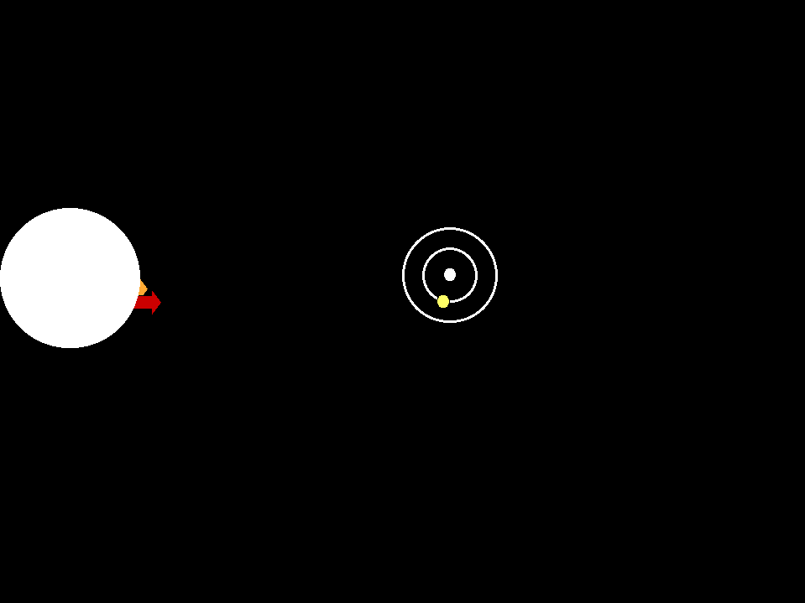
Emission vs absorption lines
Credits: G. Rieke, University of Arizona
Notes:
When the light from the new stars shine through this already enriched nebular clouds, they excite the metal atoms which leads to emission lines in our spectra. Now the difference in mechanisms of various spectra can be roughly understood from this cartoon diagram here. Which basically says that if we’re looking at a gas cloud illuminated by embedded stars, we should be able to see a combination of stellar continuum, absorption and emission line spectra. For the purpose of this talk, we are interested only in the emission lines.

Slide 21






How do emission lines originate?
Photo-ionisation
Free electron
Photon
Ground-state atom
Ion

Slide 22









How do emission lines originate?
Recombination + de-excitation
Photon emitted at frequency
$$ΔE_{1}=hν_{1}$$
$$ν_{1}$$
Free electron captured
$$ΔE_{2}=hν_{2}$$
Ion
Photon emitted at frequency
Excited atom
$$ν_{2}$$
Less excited atom
Back to ground state

Slide 23
How do emission lines originate?
Collisional excitation + de-excitation
Photon emitted at frequency
$$ΔE_{1}=hν_{1}$$
$$ν_{1}$$
Lesser-energy electron leaves
$$ΔE_{2}=hν_{2}$$
Ground-state atom
Photon emitted at frequency
High-energy free electron collides
Excited atom
$$ν_{2}$$
Less excited atom
Back to ground state

Slide 24
How do emission lines originate?
Reprocessed star light
Photon emitted at frequency
$$ΔE_{1}=hν_{1}$$
$$ν_{1}$$
Photon absorbed
$$E=hν=h(ν_{1}+ν_{2})$$
$$ΔE_{2}=hν_{2}$$
Ground-state atom
Photon emitted at frequency
Excited atom
$$ν_{2}$$
Less excited atom
Back to ground state

Slide 25









Emission lines are specific to energy level transitions
n = 4
Higher energy, shorter wavelength
n = 3
n = 2
Lower energy, longer wavelength
n = 1

Slide 26
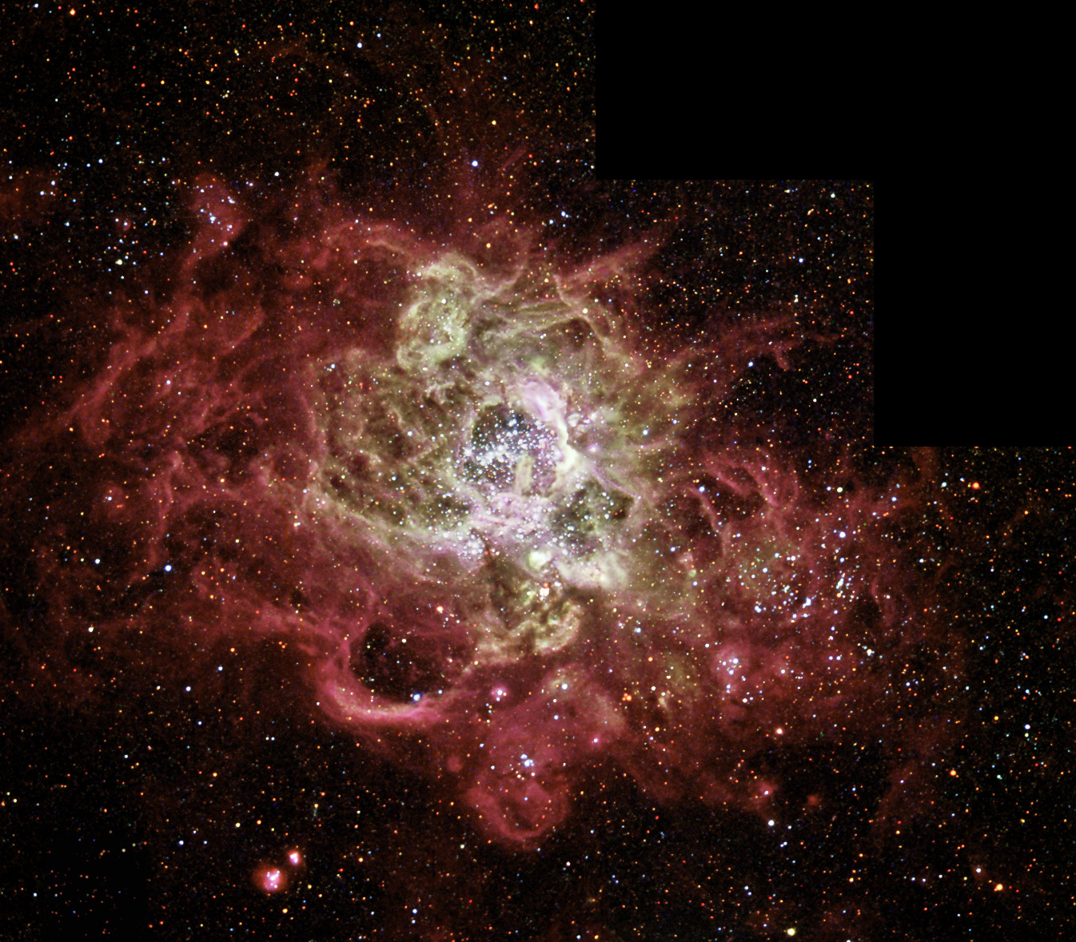
What do we actually look at? Gas around stars
NGC604; Courtesy: NASA/ESA and The Hubble Heritage Team (AURA/STScI)
Notes:
this is an image of a certain nebula, where new stars forming at the centre. as the starlight travels outwards, it excites the gas around it and then the gas emits its own light. this is what we call nebular emission. once that light reaches us..

Slide 27
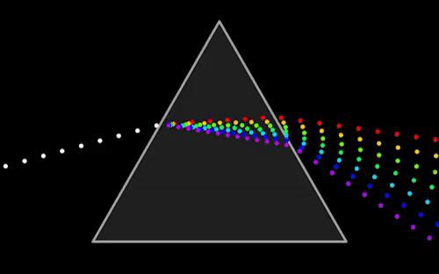
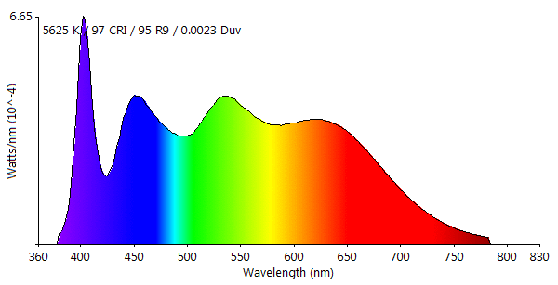
Spectra from the gas cloud
Notes:
we capture through a spectrograph, which essentially works like a prism and breaks the light into its different colors. now the strength of this different colors vary..some are brighter and thus have strong peaks. these peaks are what we call nebular emission lines.

Slide 28
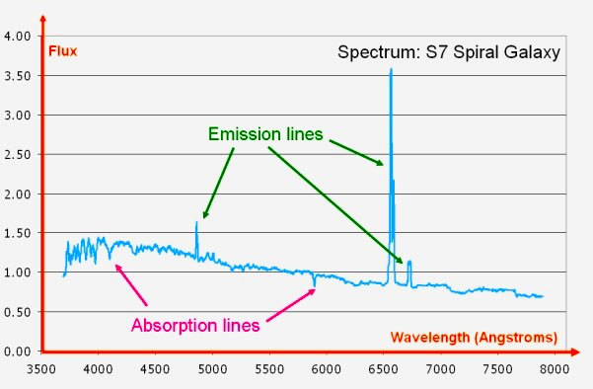
How do emission-line spectra look?
Credits: CAS, Swinburne

Slide 29
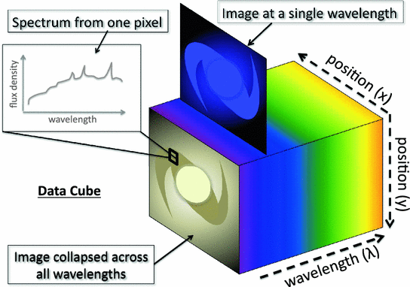
Integral Field Unit (IFU) Spectroscopy
Credits: Christopher Mark Harrison

Slide 30
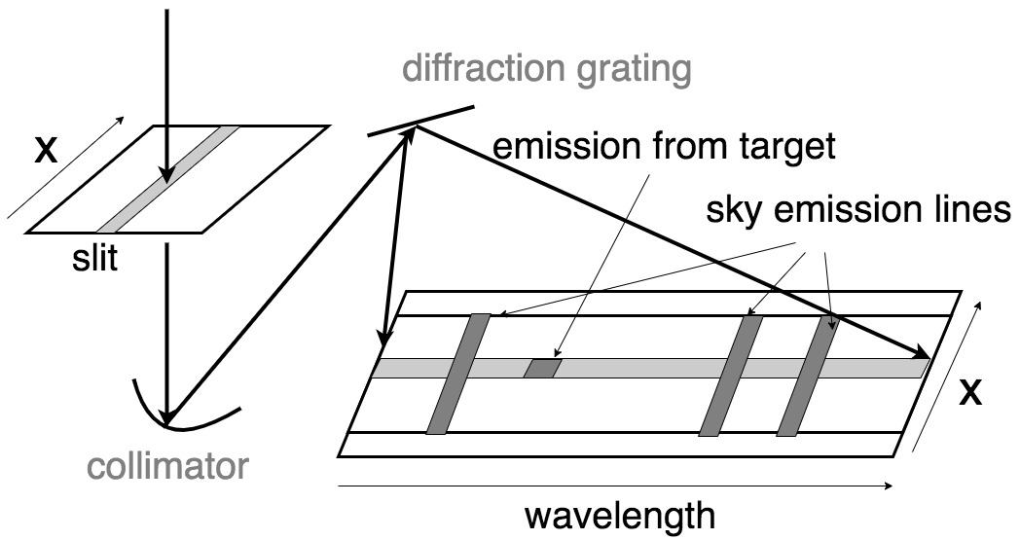



Long Slit Spectroscopy

Slide 31



Emission line fitting
Data
Fitted Gaussian
Height
$$(h)$$
Turbulence in gas,
velocity disperson
Flux
Full width at Half Maximum
$$(σ)$$
Continuum
Age, mass of star
$$(c)$$
Centroid
Velocity of gas
$$(λ_{0})$$
Flux
= Area under the Gaussian
$$=\sqrt{2π}×h×σ$$
Wavelength
$$h$$
$$σ$$

Slide 32



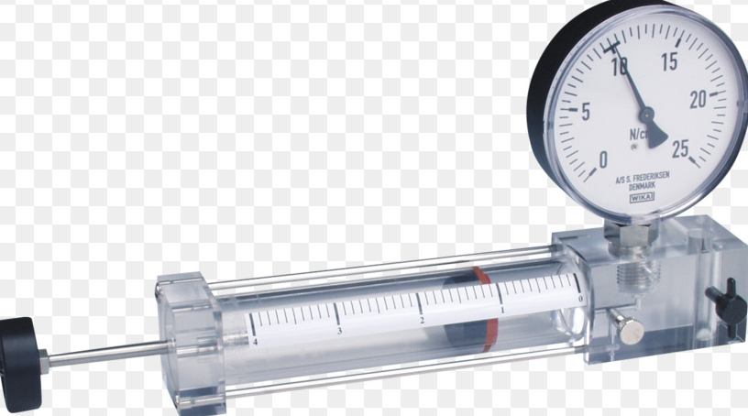
Nebular emission lines
How much Oxygen?
How dense?
How much pressure?
How hot?
NGC604; Courtesy: NASA/ESA and The Hubble Heritage Team (AURA/STScI)
Notes:
but why do we want to study these emission lines? what do they tell us? well they contain a wealth of information about the physical conditions of the nebular gas, or the ISM. things like how much oxygen is present in the gas, how dense or hot the gas is..or how pressurised is it. these factors are important to study because they will in turn affect the next generation of star formation in this cloud and dictate the evolution of this galaxy as a whole

Slide 33
Nebular emission lines
How much Oxygen?
How dense?
Metallicity
Electron density
Emission line diagnostics
How hot?
How much pressure?
Electron temperature
ISM Pressure
How fast is the gas moving?
Outflows
Notes:
Just a recap of the things we want to infer from the emission lines - the oxygen abundance, aka metallicity, the electron temperature and density, the ism pressure and the ionisation parameter which is essentially a measure of how fast the front of the ionising radiation is moving through the gas. but how do we get all this info just by measuring the strength of the emission lines? the answer is: magic. and this magic is known as emission line diagnostics!

Slide 34
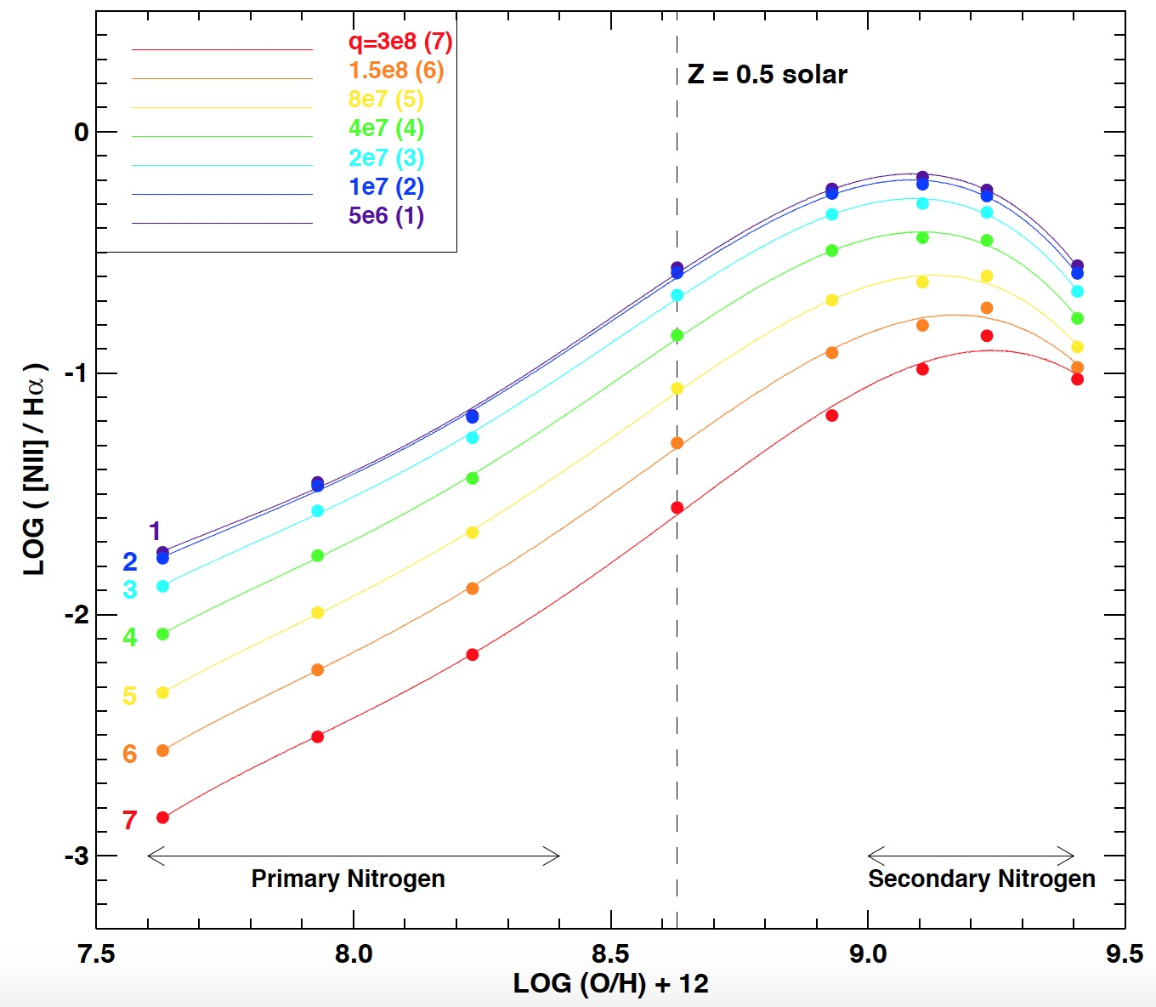
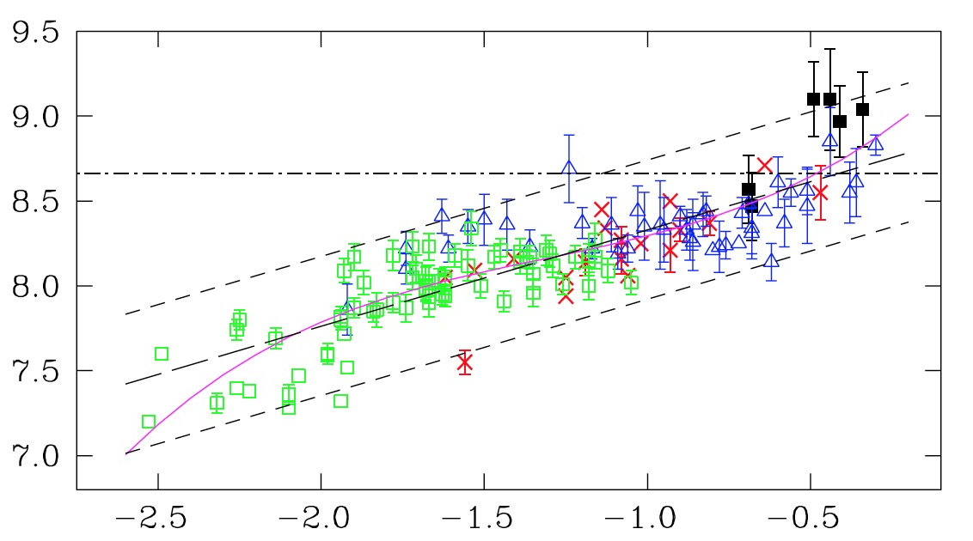
Examples of emission line diagnostics*
NII/H-alpha flux ratio
Oxygen abundance
NII/H-alpha flux ratio
Pettini & Pagel 2004
Oxygen abundance
*diagnostics = formulae to convert flux ratios into physical quantities
Kewley+2002

Slide 35

At larger distance we see only the Ultraviolet spectra from galaxies
Why? How?
Therefore, need to develop and build new diagnostics applicable for Ultraviolet spectra

Slide 36
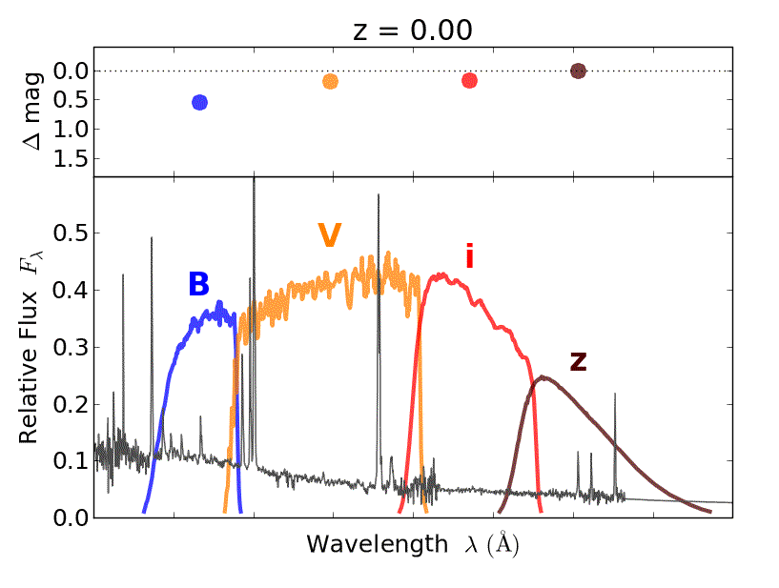






Redshifted spectra
Redshift
Higher redshift = More distant galaxy
Observed wavelength (fixed)
For high redshift, we observe rest-frame Ultraviolet spectra
For low redshift, we observe rest-frame optical spectra
Ultraviolet
Optical
Rest-frame wavelength (Varies with redshift)
Credits: kaggle InClass competition

Slide 37
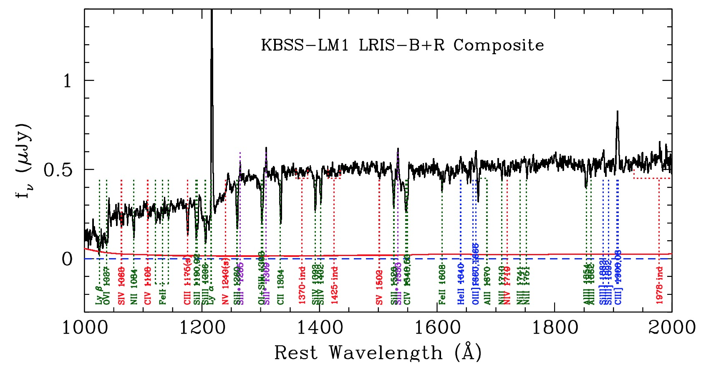

Example of rest-frame UV spectra
Redshift ~ 2, composite spectra
C III 1907,9
O III 1660,6
Steidel+2016

Slide 38
My research

Slide 39
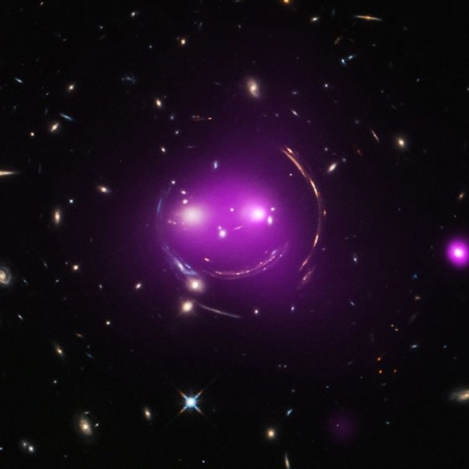
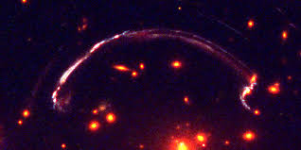

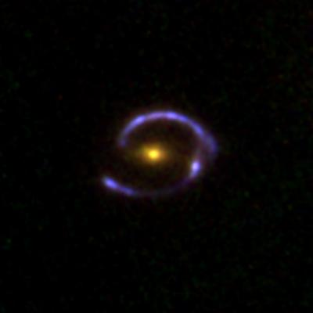
Where do we look for it?
As far back in the past as we can!
Credit: Gonzalez-Lopez et al. 2017
Credit: NASA HST/Chandra Telescope
I observed this and applied new UV diagnostics to it
Credit: Mark Swinbank/Durham University
Notes:
Why gravitational lensing?
Lensing magnifies the otherwise faint high redshift galaxies
Lensing stretches the galaxy into arcs, which means we can spatially resolve different star forming knots, as you can see here!

Slide 40
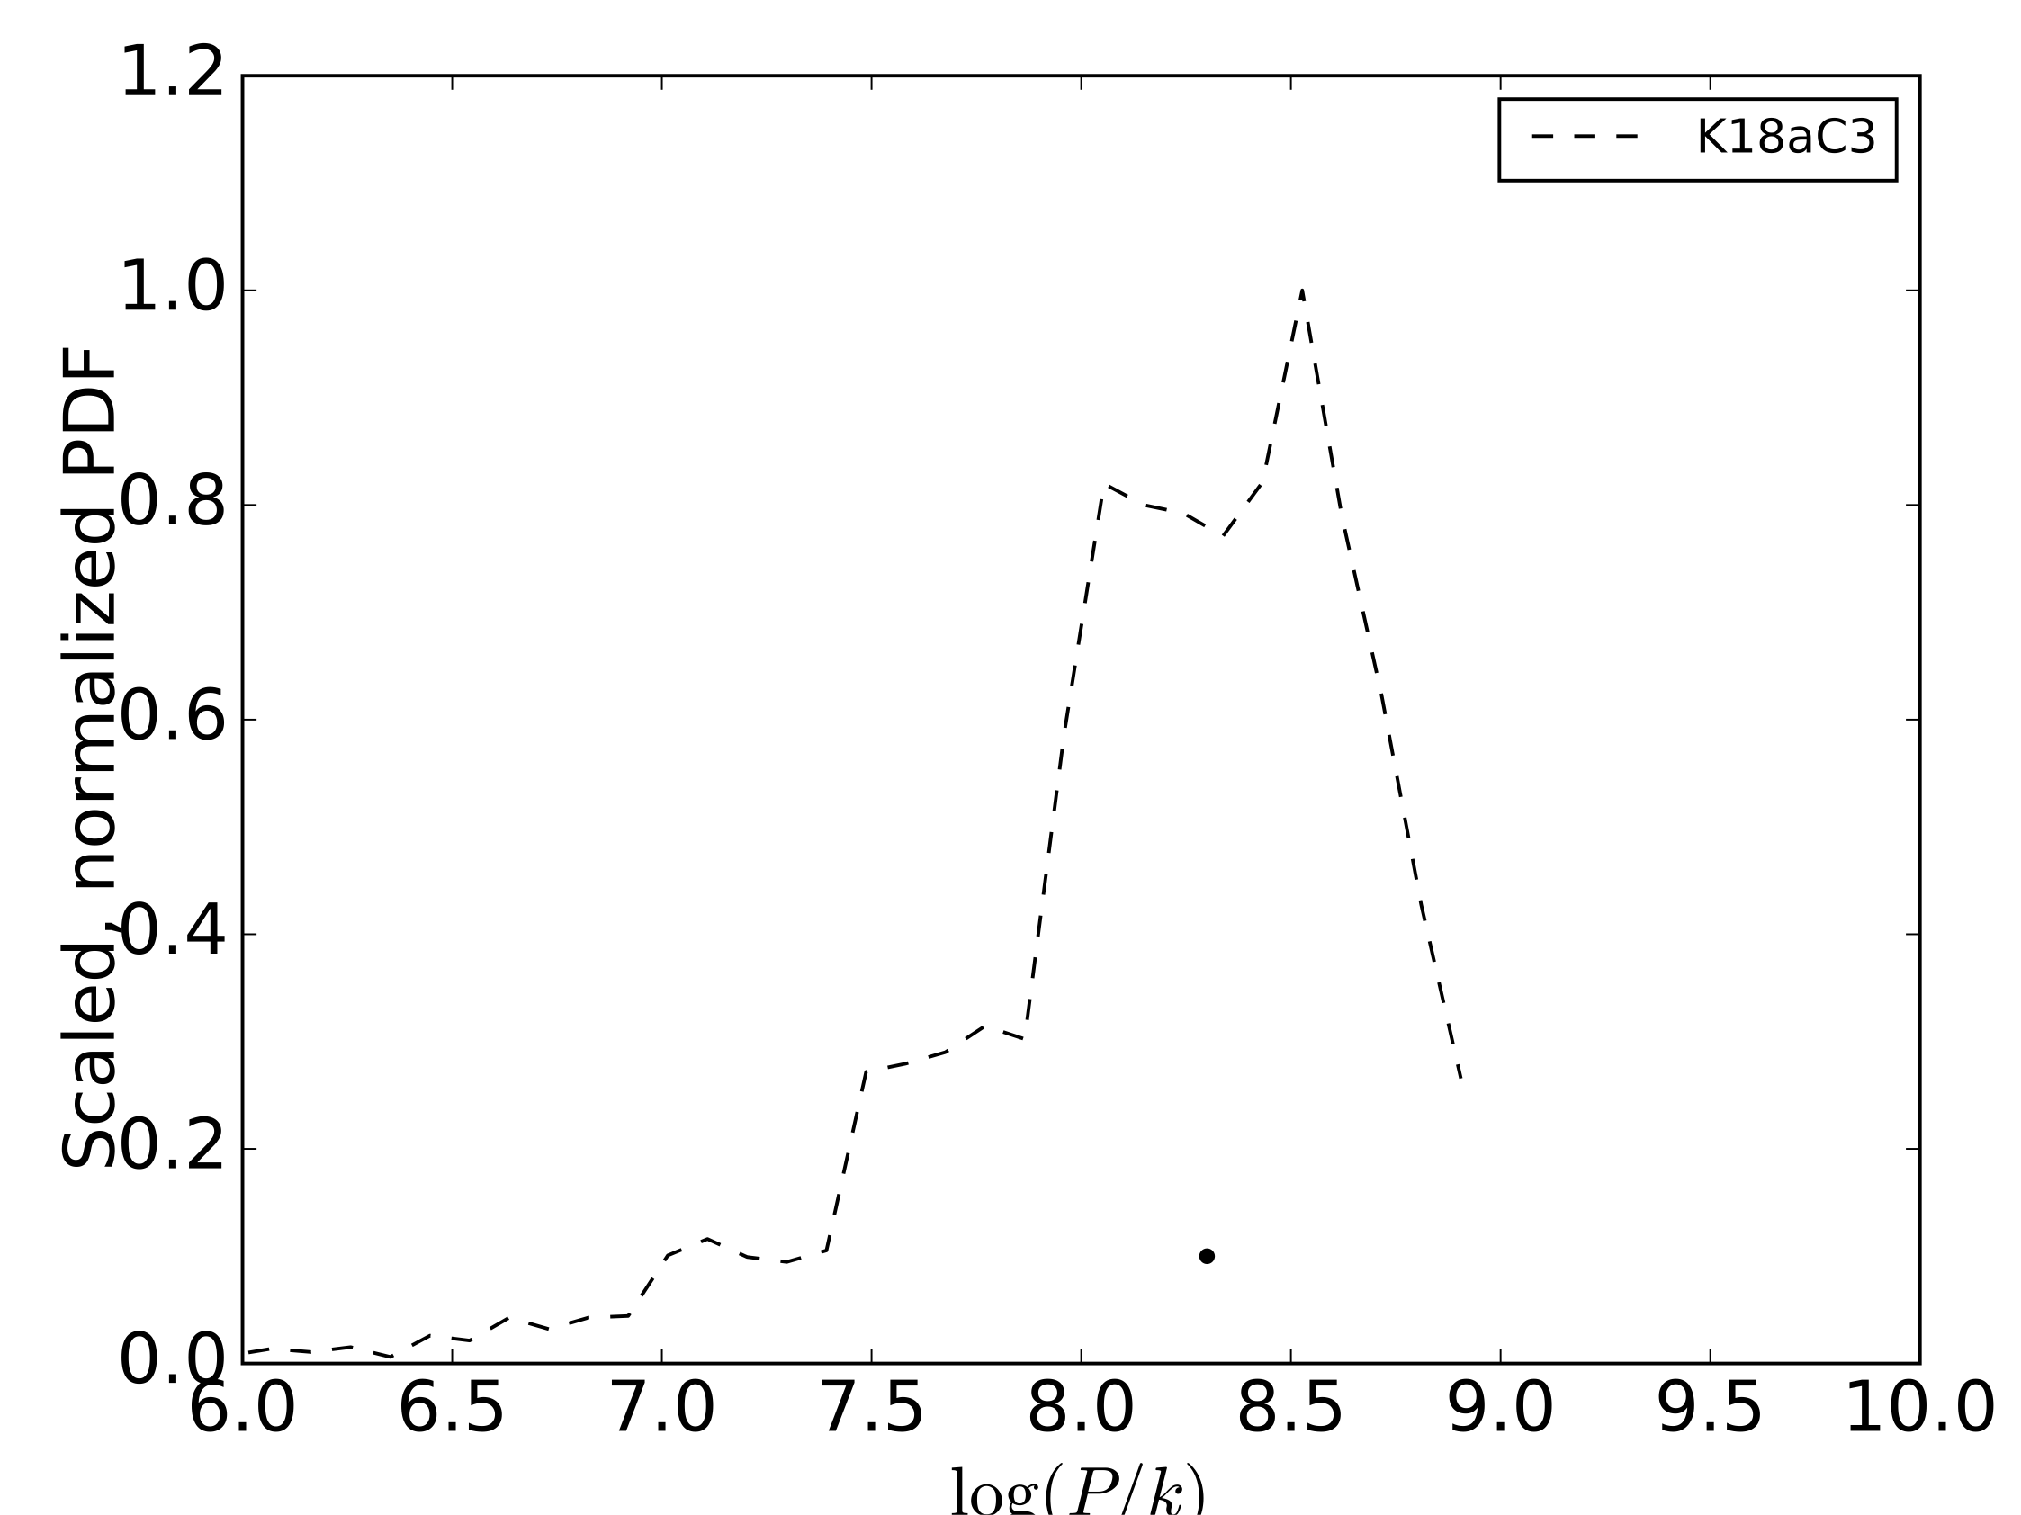
UV vs Optical diagnostics
UV
C III ratio
Scaled, normalised PDF
Pressure: log(P/k)
Notes:
This is what my next few plots will look like so i’ll explain the format first. for each emission line diagnostic we performed a monte carlo technique..that is to say..we randomly drew the emission line flux from a gaussian distribution with mean and std dev equal to the measured flux and its uncertainty. we repeat this process 10000 times, which gives us 10000 randomly drawn line ratios, and as a result, 10000 estimated values of pressure. we plot that as a probability distribution function here. the width of the pdf is a measure of how well constrained our pressure measurement is with the given diagnostic. the dot shows the median of the pdf. dashed lines correspond to uv diagnostics and..

Slide 41
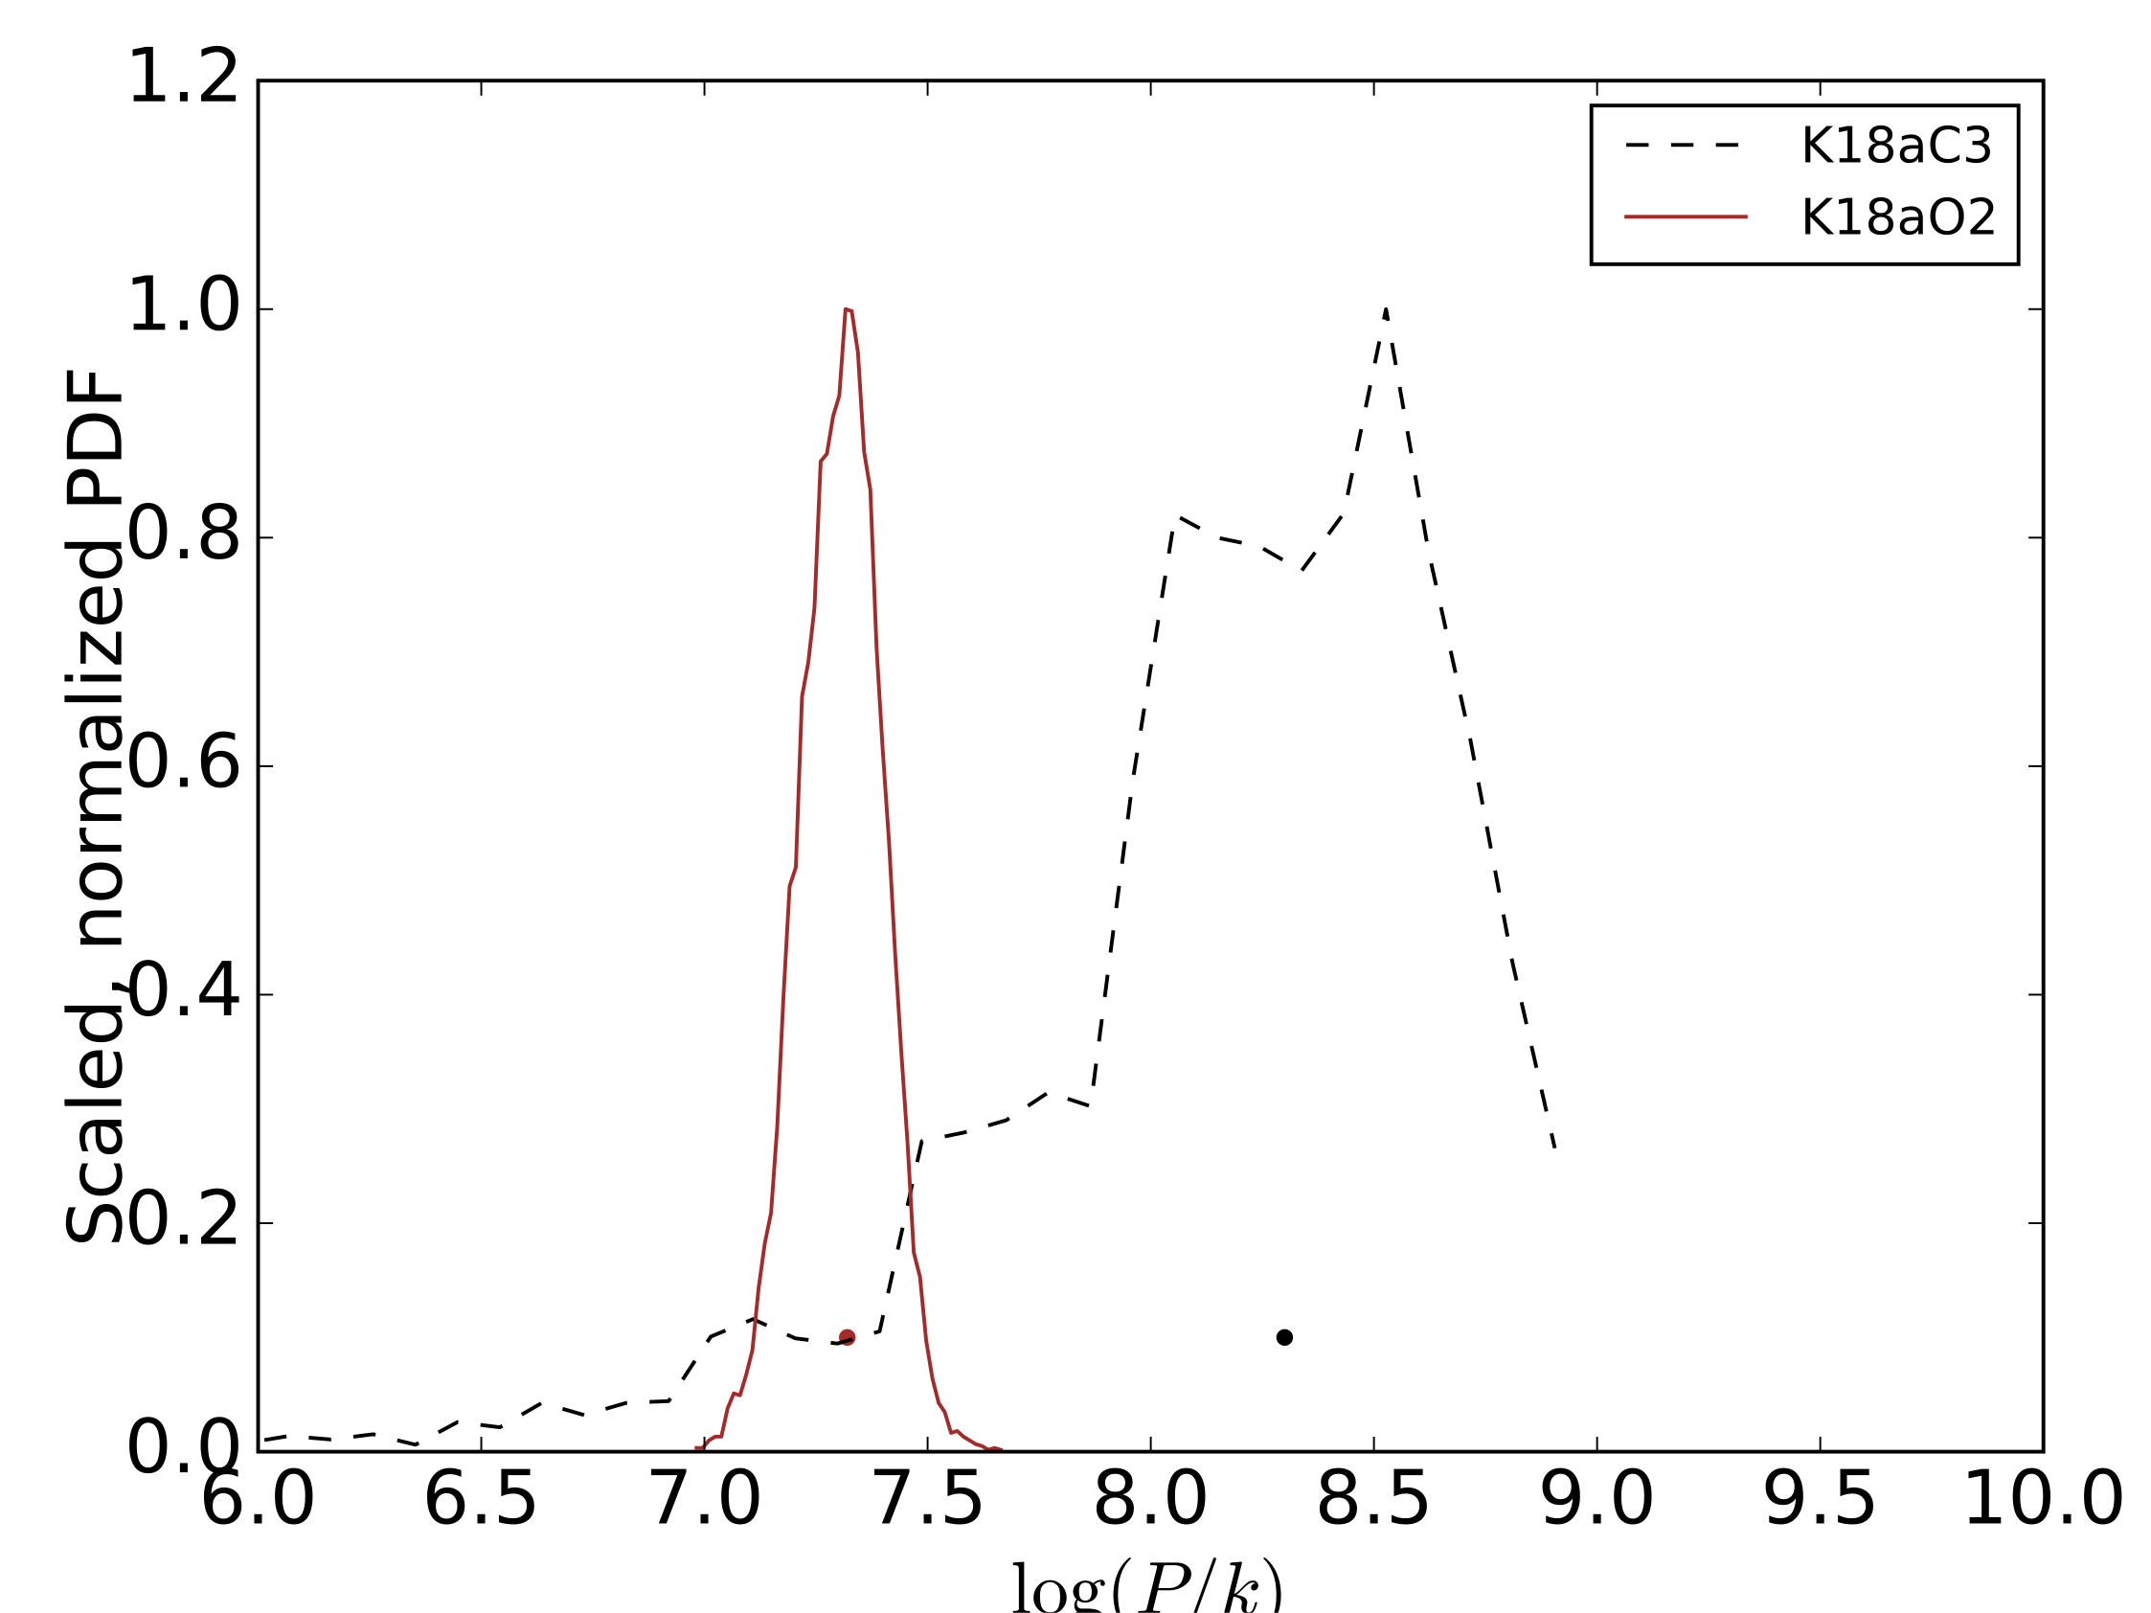
UV vs Optical diagnostics
UV
C III ratio
Optical
O II ratio
Scaled, normalised PDF
Pressure: log(P/k)
Notes:
..solid lines correspond to optical diagnostics..

Slide 42
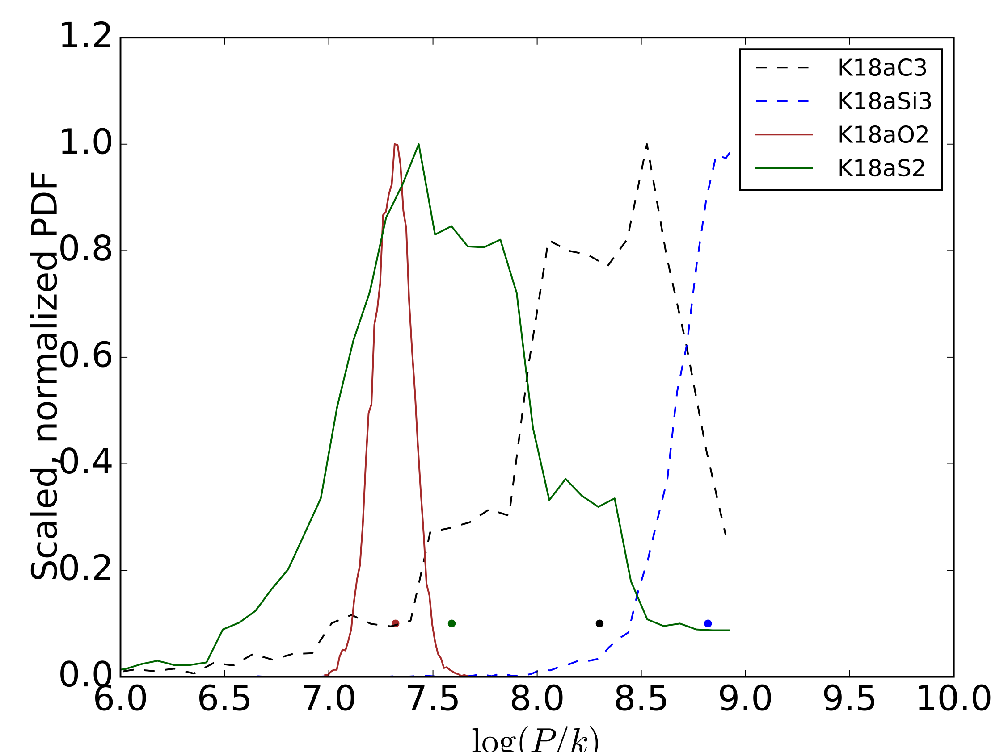
UV vs Optical diagnostics
UV
C III ratio
Optical
O II ratio
Si III ratio
S II ratio
Scaled, normalised PDF
Pressure: log(P/k)
Acharyya et al. 2019
Notes:
..adding a couple more diagnostics, based on different emission line ratios. we can clearly see an offset here. pressures derived using UV diagnostics, the dashed lines, are consistently higher than those based on the optical lines

Slide 43
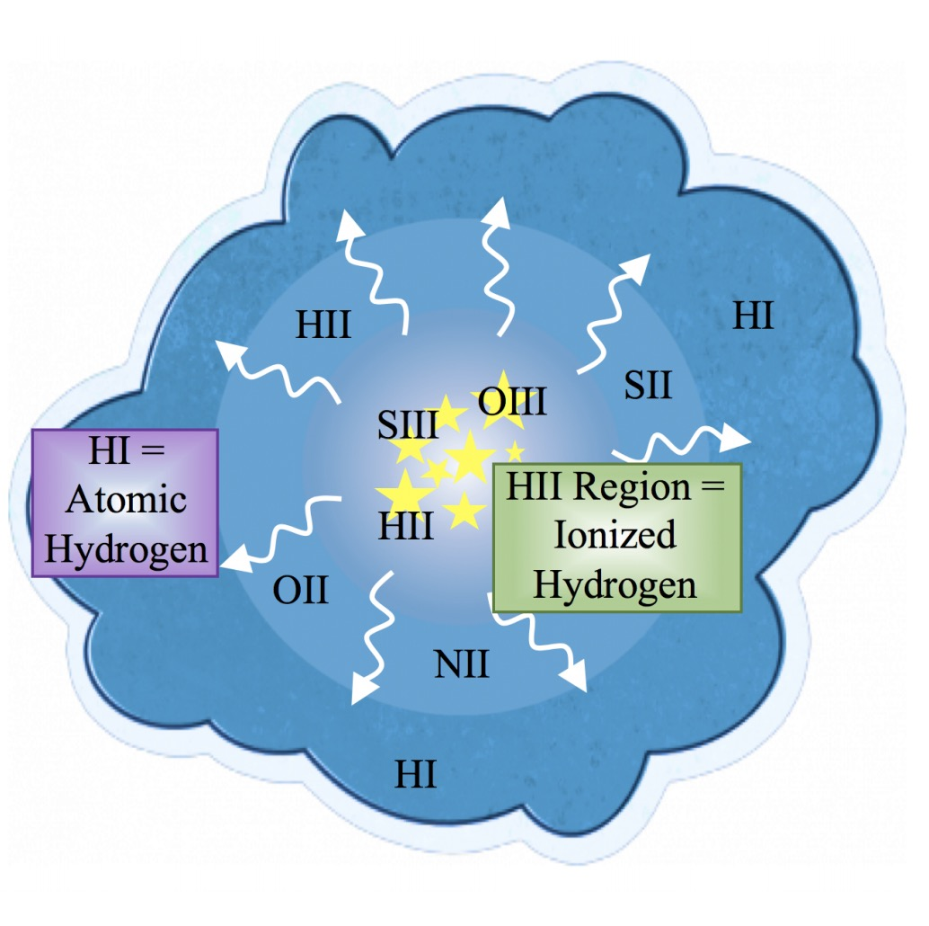
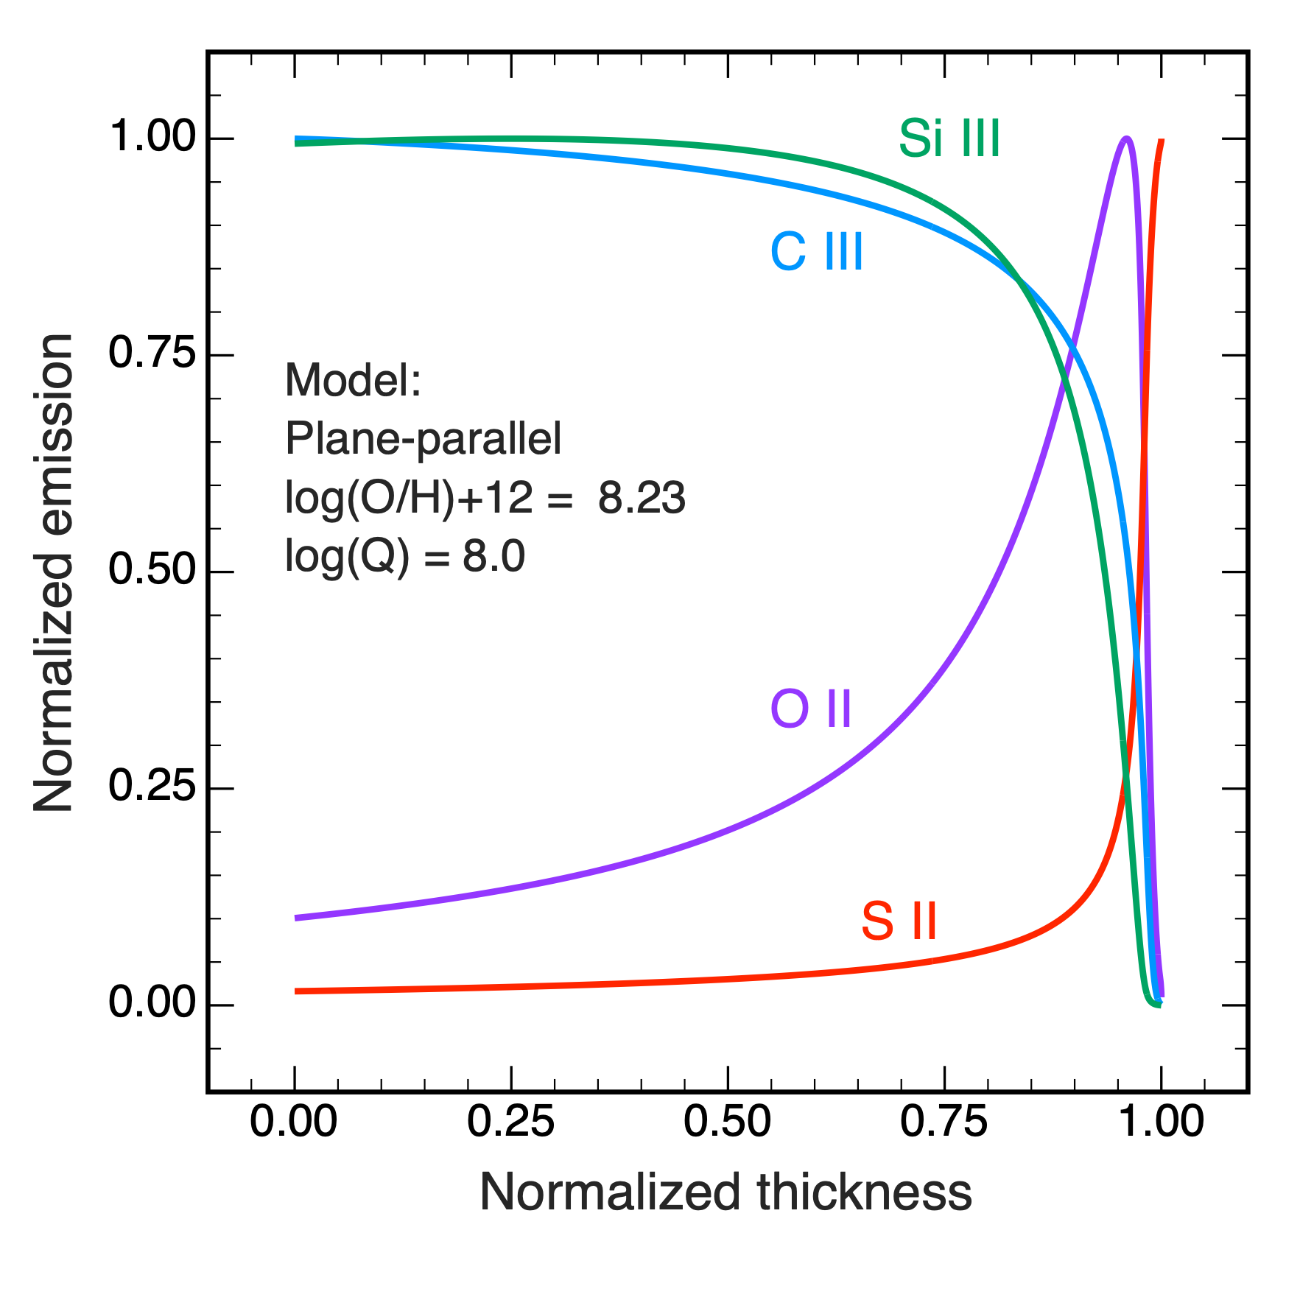
Why does UV yield higher pressure?
SiIII
Courtesy: Mayker 2019
Kewley+2019a, Acharyya+2019
Notes:
this happens because the different emission lines originate from a physically different part of the nebula. as can seen in this figure, the uv c3 and si3 lines, due to their higher ionisation potentials are mostly from the inner parts of the nebula which is more pressurised, whereas the optical s2 and o2 lines trace the outer edge..which has less pressure and is less dense. so it is not surprising that uv would yield higher pressure than optical lines..but it is worth noting, bearing in mind that pressures measured in future high redshift surveys with the uv line ratio would not be readily comparable to those measured in the local universe with optical lines, not at face value at least.

Slide 44
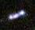
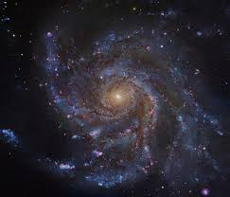
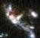
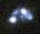
Challenges in looking so far out?
Farther galaxies are difficult to spatially resolve -> images are blurred
Distant galaxies
Nearby galaxies

Slide 45
But how to measure things correctly?
I produced mock IFU data cubes
…by converting a simulated galaxy into what it would look like if it had been observed through a telescope
Notes:
Thank you for your time. I’d be happy to take questions :)

Slide 46
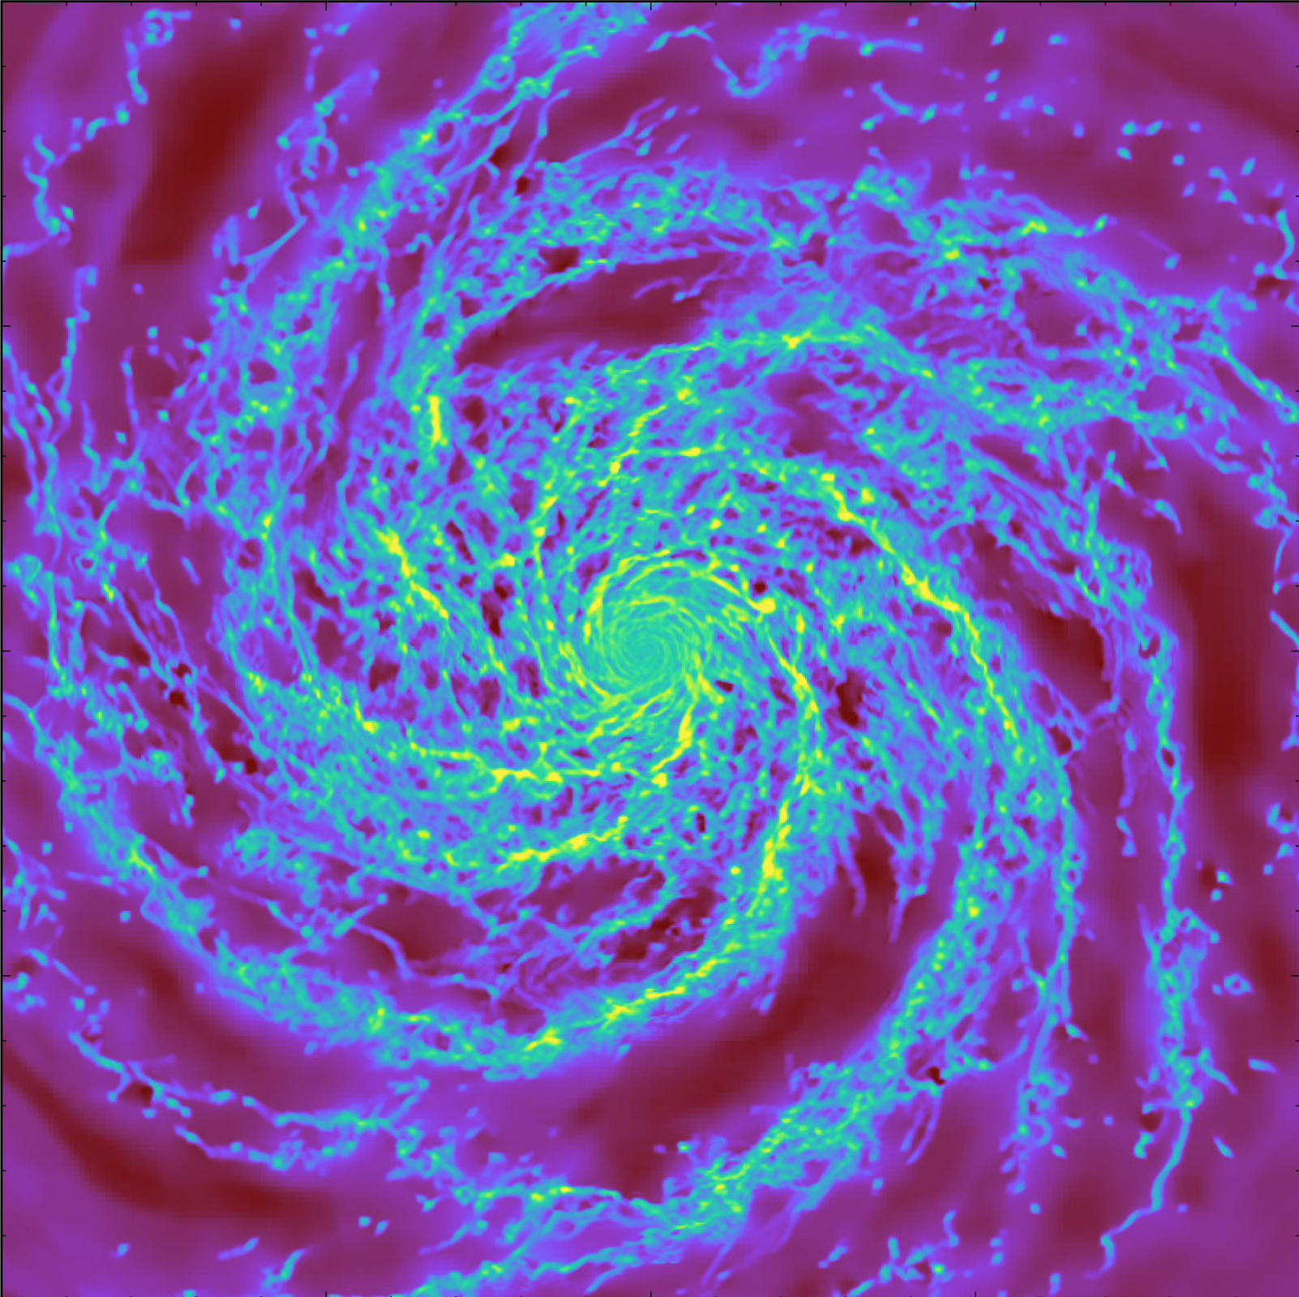
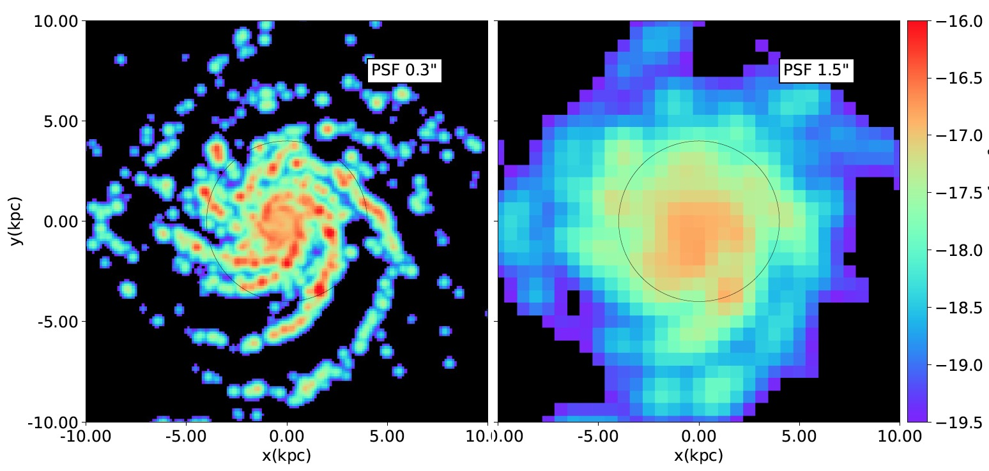
How it looks to us
How it really is…
With an unrealistically good telescope..

Slide 47
How it looks to us
How it really is…
With a good telescope..

Slide 48
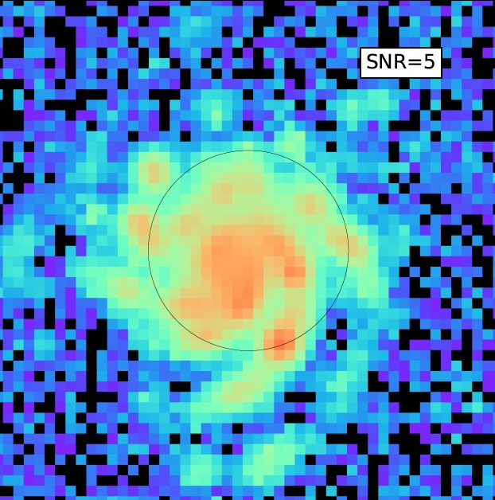
How it looks to us
How it really is…
With a typical telescope..

Slide 49
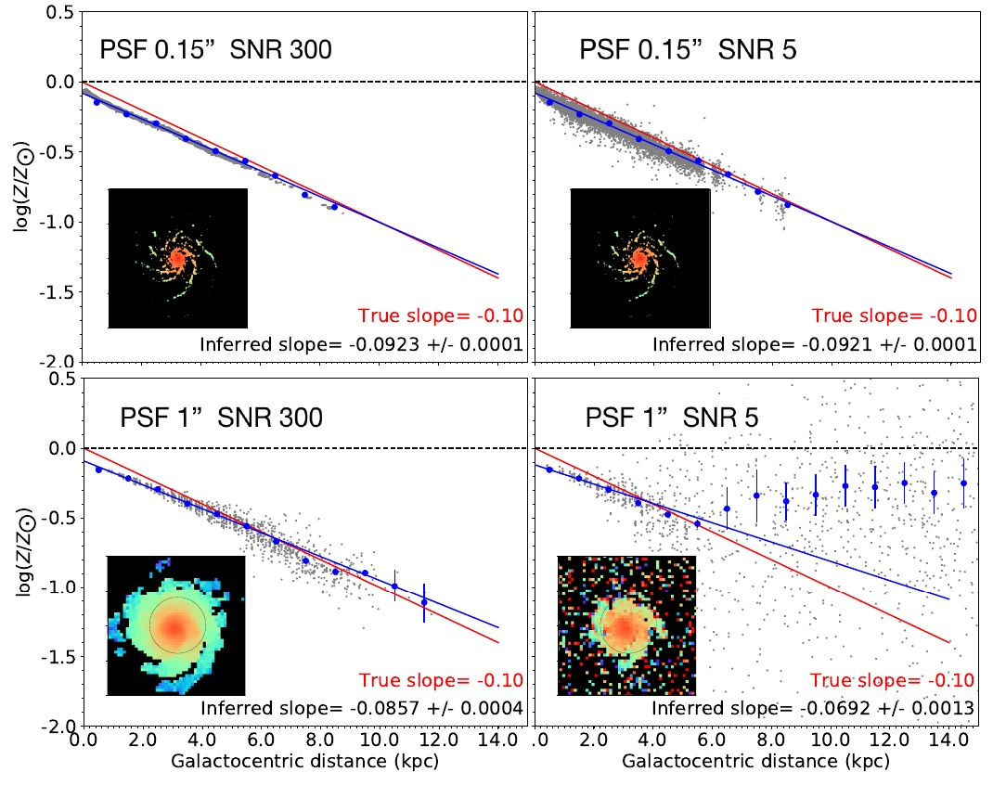

Metallicity profile
Oxygen abundance
Distance from center of galaxy (kpc)
Acharyya et al. 2020

Slide 50
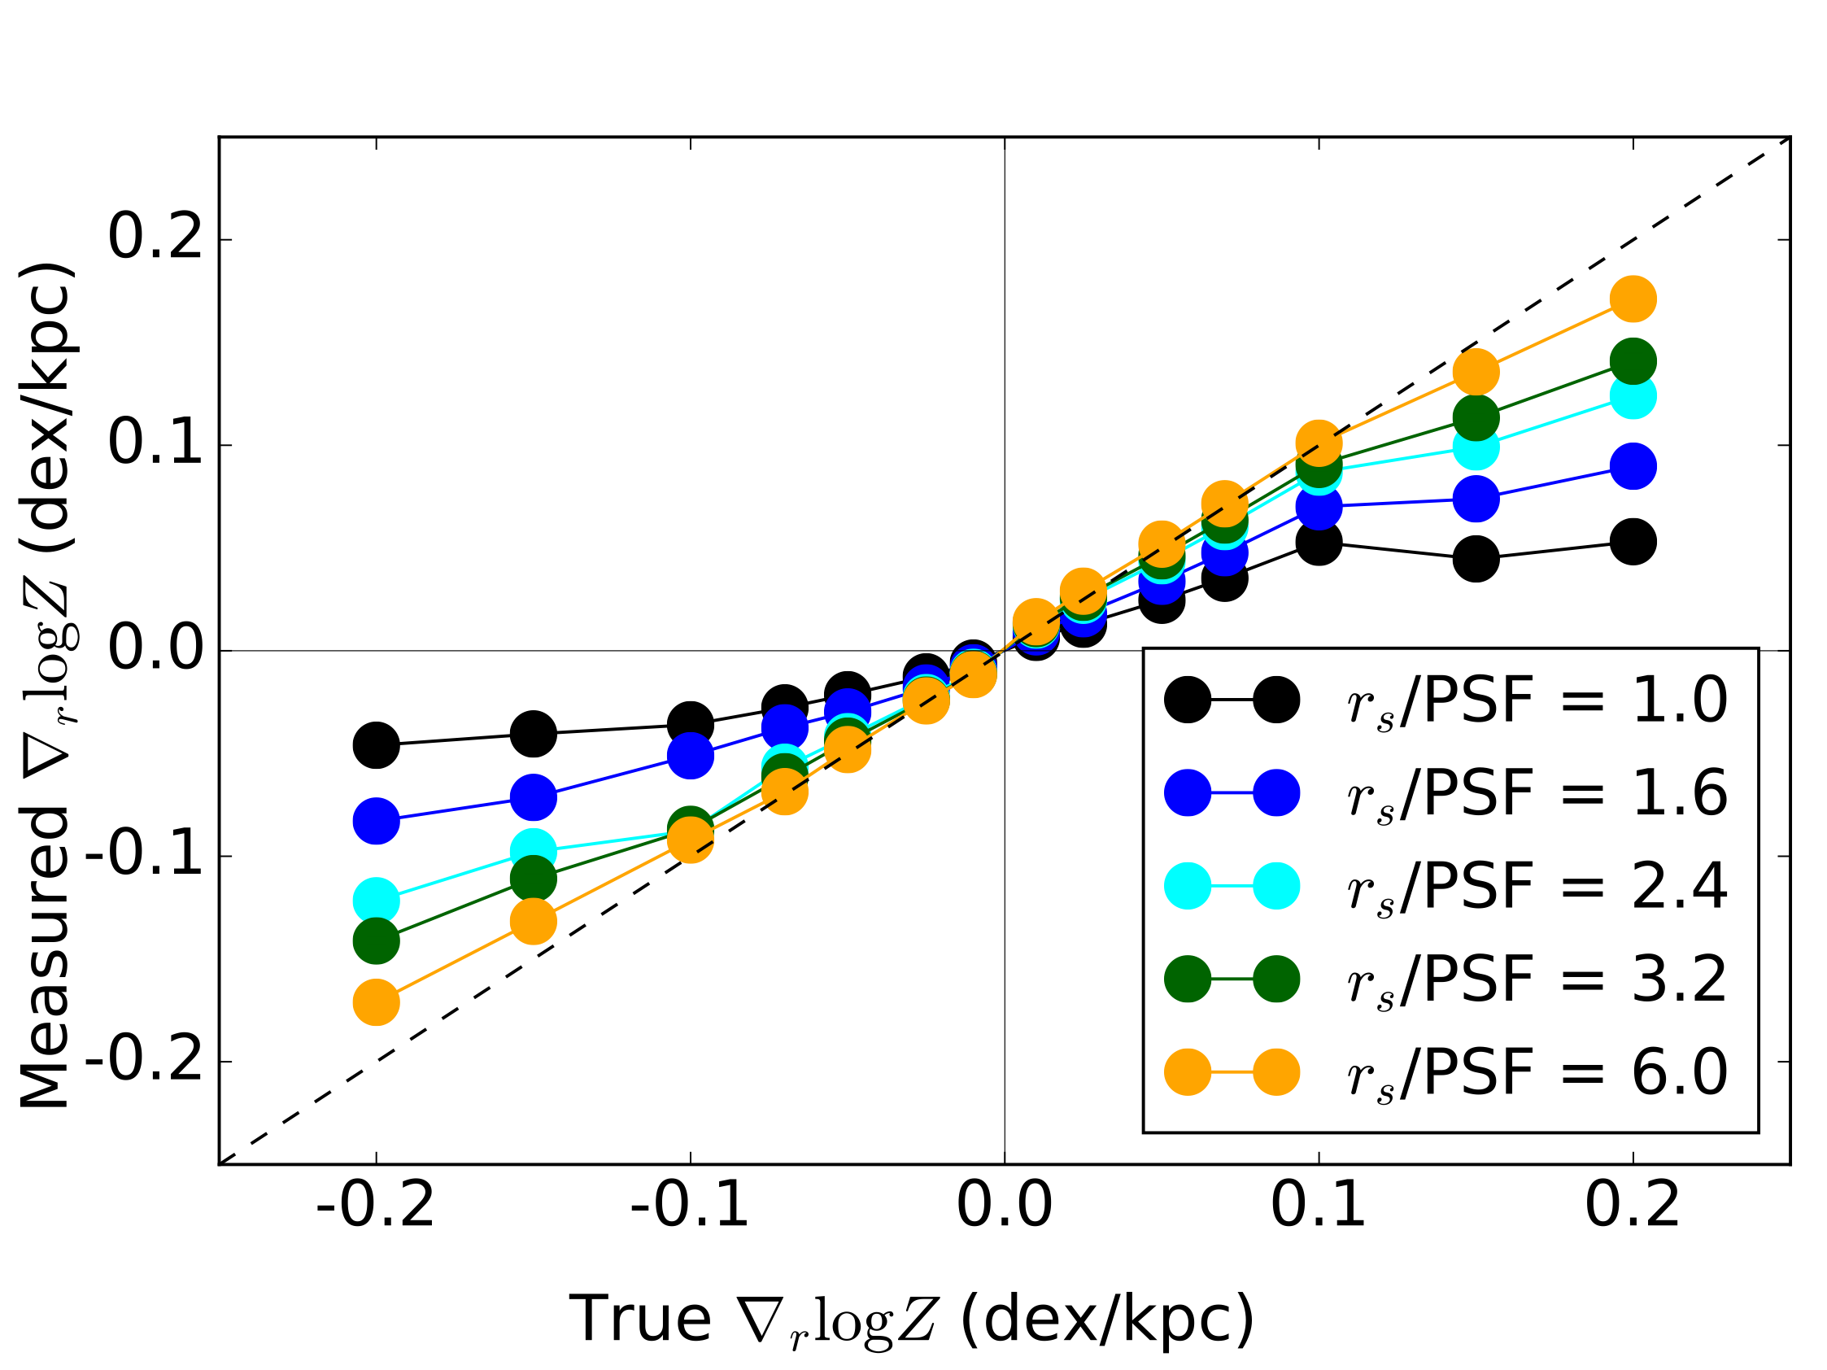



Metallicity profile
Poorer image quality leads to artificially shallower gradients
Measured gradient (dex/kpc)
Blurred image
Sharp image
Real gradient (dex/kpc)
Acharyya et al. in prep

Slide 51
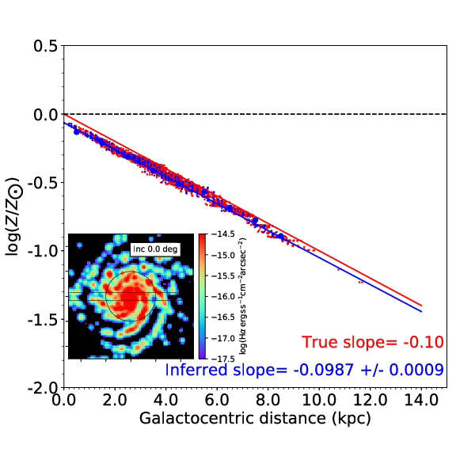
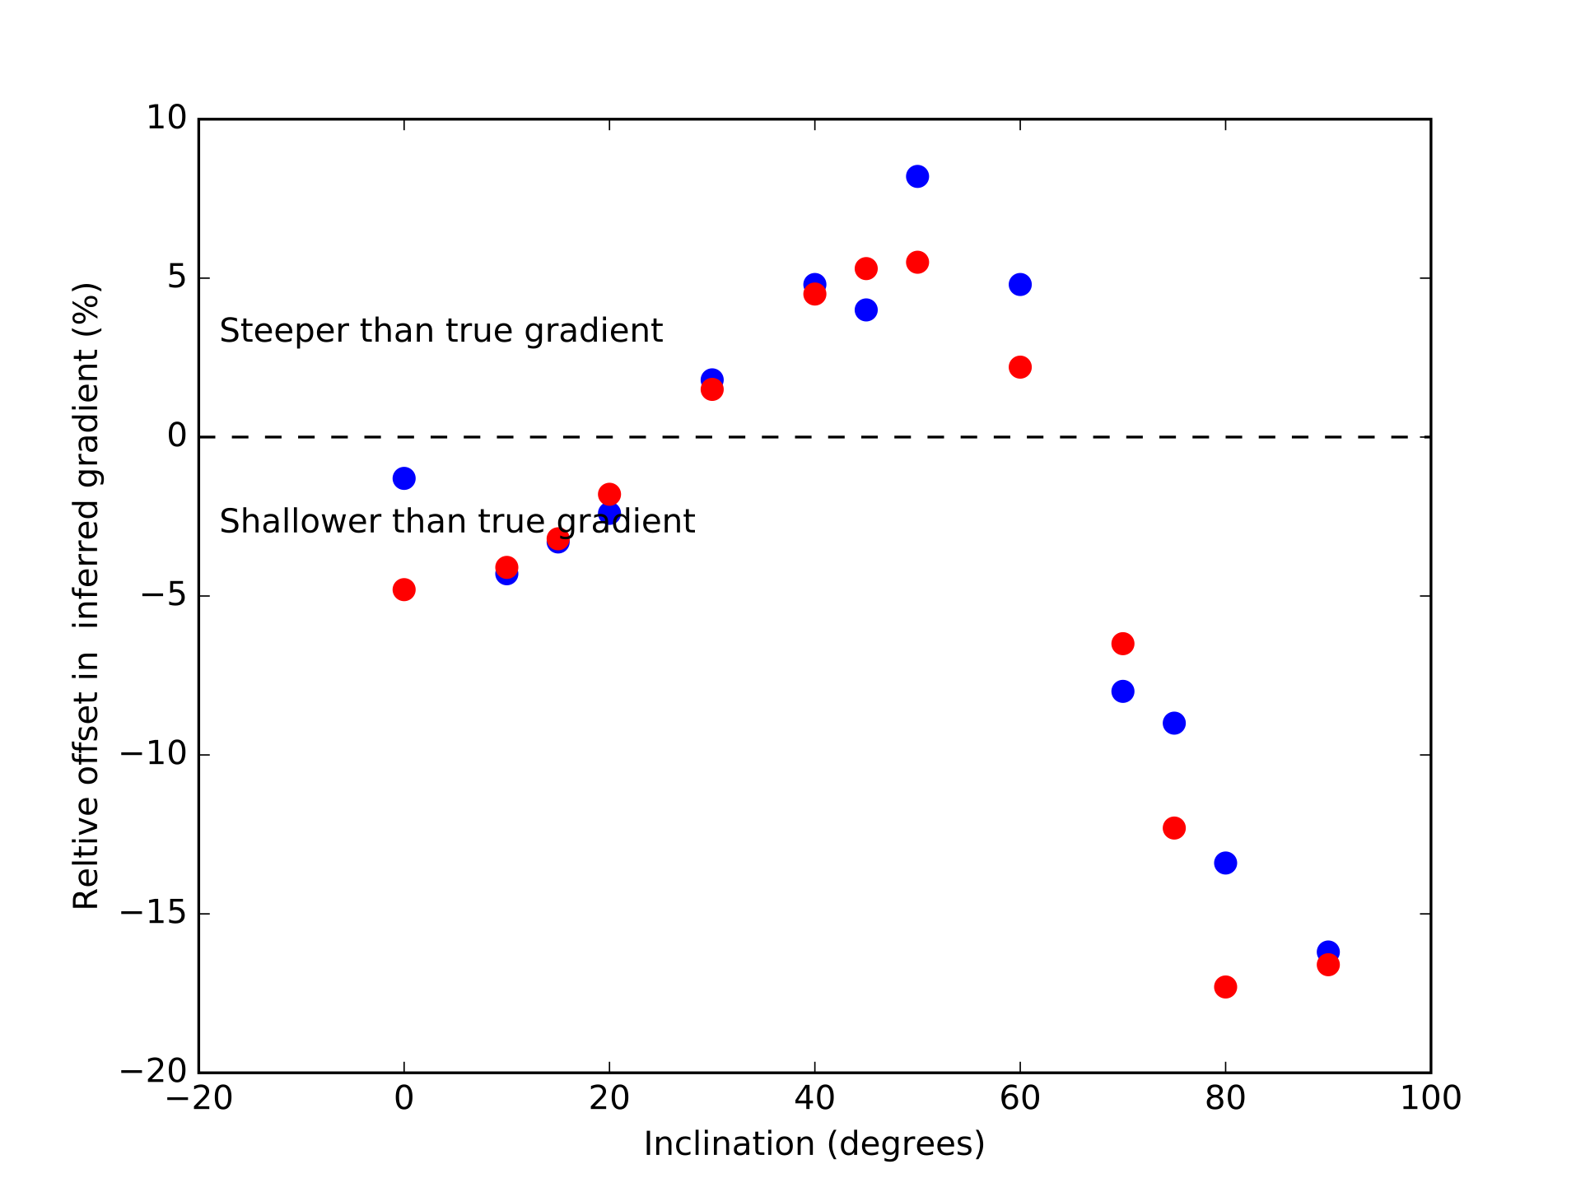
Effect of inclination
Resolution = 0.5’’
log(Z/Z_sol)
Relative offset in gradient (%)
Resolution = 0.5’’
Inclination (degrees)
Galactocentric distance (kpc)

Slide 52
Take home messages
Astronomers do both observing through telescopes and simulating galaxies in a computer.
Spectroscopy is an essential tool to study gas in galaxies.
We will be able to see really far back in to the past of the Universe with some upcoming telescopes.
But we need to carefully analyse the blurred images from distant galaxies.
Notes:
Thank you for your time. I’d be happy to take questions :)

Slide 53
Thank you!
Questions?
Notes:
Thank you for your time. I’d be happy to take questions :)

Slide 54
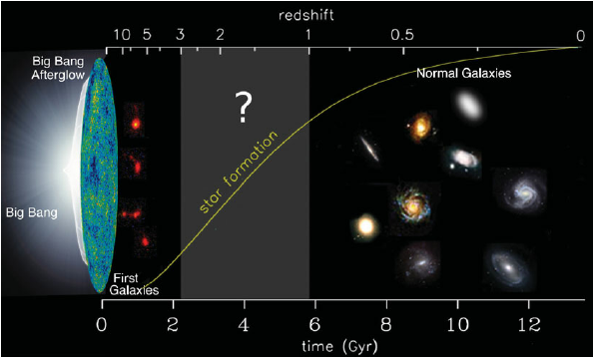
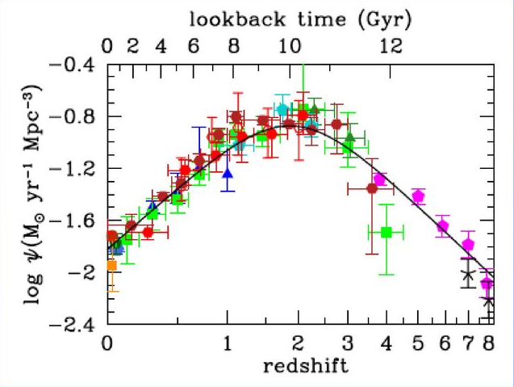
Why study the high-redshift Universe?
Most stars formed during z~2
Star formation impacts host galaxy evolution (e.g. metal enrichment)
Madau & Dickinson 2004
Labbé 2010
Notes:
particularly, there is a period known as the cosmic noon when star formation in the universe was at its highest. because star formation is both dependent on and dictates the properties of the interstellar medium, this period is of utmost importance..and we don’t fully understand the processes at play around this epoch.

